Slide 1
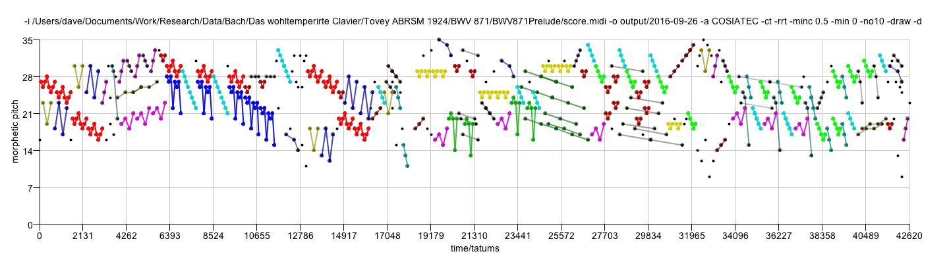

OMNISIA
David Meredith

Slide 2
OMNISIA
OMNISIA is an implementation in Java of the following SIA-based algorithms
  SIA
  SIATEC
  COSIATEC
  Forth’s algorithm
  SIATECCompress
  RecurSIA

Slide 3
Switches
-a Basic algorithm to use. Possible values are: SIA, SIATEC, COSIATEC, SIATECCompress, Forth, RecurSIA. Default is COSIATEC.
-i Path to input file (REQUIRED).
-o Path to output directory. Default is same directory as input file.
-d If present, then use morphetic (diatonic) pitch instead of chromatic pitch. If morphetic pitch is not available in the input data (e.g., MIDI format), then input data is pitch-spelt using the PS13s1 algorithm.
-h Help. If present, then this help screen to be printed. This happens if the program is called with no arguments or if it is unable to determine the values of all necessary parameters from the arguments provided.
-m If present, generates output in MIREX format.
-ct If present, uses Collins' compactness trawler, as used in his SIACT and SIARCT-CFP algorithms.
-cta The variable which Collins et al call 'a'. It is the minimum compactness permitted in the trawled patterns.
-ctb The variable which Collins et al call 'b'. It is the minimum size of the patterns trawled by the compactness trawler.
-rsd If present, limits SIA to r superdiagonals, as used in Collins' SIAR algorithm. Number of superdiagonals determined by the -rswitch.
-r Number of superdiagonals to analyse if limited with -rsd switch. Default value is 1.
-rrt If present, redundant translators are removed.
-minc Threshold value for minimum TEC compactness (default is 0.0).
-min Minimum allowed pattern size. Default is 0.
-max Maximum allowed pattern size. Default is 0, which means that patterns of all sizes are allowed.
-merge If present, TECs are merged.
-minm Minimum match size if TECs are merged. Default value is 5.
-spins Number of iterations if TECs are merged. Default value is 10.
-no10 If present, channel 10 (drum channel) is removed if input is in MIDI format.
-draw If present, generates an image file containing a visualization of the analysis.
-crlow Minimum compression ratio in Forth's algorithm. Default is 0.2.
-crhi Maximum compression ratio in Forth's algorithm. Default is 1.0.
-comlow Minimum compactness threshold in Forth's algorithm. Default is 0.2
-comhi Maximum compactness threshold in Forth's algorithm. Default is 1,0
-cmin c_min threshold in Forth's algorithm. Default is 15
-sigmin sigma_min threshold in Forth's algorithm. Default is 0.5.
-bbcomp If present, use bounding-box compactness in Forth's algorithm instead of within-voice segment compactness.
-nodate If present, then does not append date to output directory names.
-bbmode If present, then uses BB mode when generating output in MIREX format.
-segmode If present, then uses Segment mode when generating output in MIREX format.
-out If present, overrides -o and prints a single output encoding to the given path.
-top If present, limits output to top N patterns.
-recalg If RecurSIA is main algorithm used, then value of this switch determines which basic algorithm is used on each pattern. Possible values are COSIATEC, SIATECCompress or Forth.
-sortpat When using COSIATEC, getBestTEC sorts TECs with preference given to TECs with larger patterns.

Slide 4

Prelude in C minor from WTCII
BWV871

Slide 5
Combining switches
-a COSIATEC -ct -rrt -minc 0.5 -min 0 -no10 -draw -d
numberOfNotes 692
compressionRatio 2.283828382838284
runningTime 3661
encodingLength 303
encodingLengthWithoutResidualPointSet 231
numberOfResidualPoints 72
percentageOfResidualPoints 10.404624277456648
compressionRatioWithoutResidualPointSet 2.683982683982684
numberOfTECs 26
isDiatonic true

Slide 6
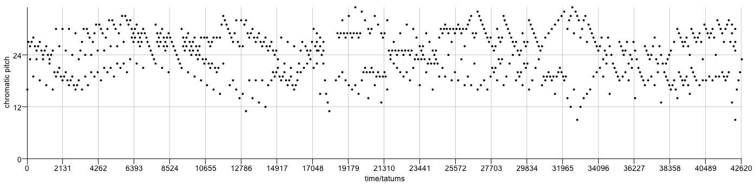
Input point set
(Prelude in C minor from WTC II
BWV 871)

Slide 7
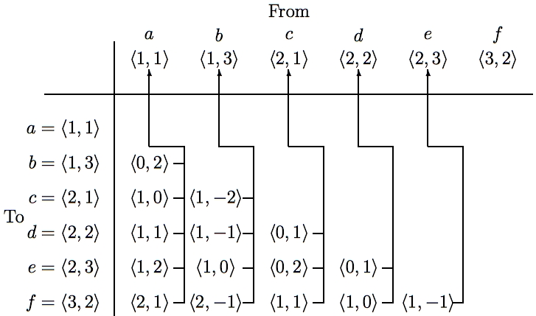
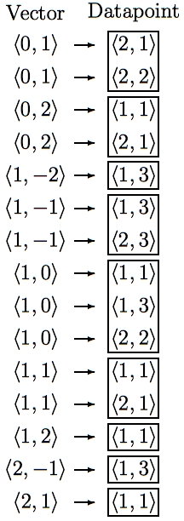
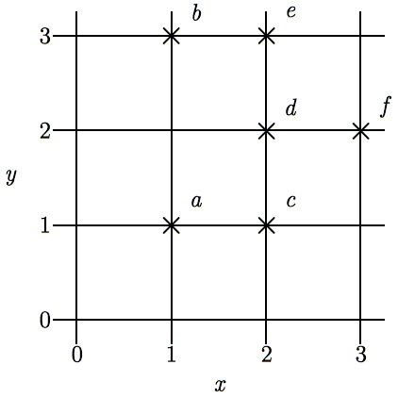
SIA - Discovering all maximal translatable patterns (MTPs)
Pattern is translatable by vector v in dataset if it can be translated by v to give another pattern in the dataset
MTP for a vector v contains all points mapped by v onto other points in the dataset
O(kn² log n) time, O(kn²) space
O(kn²) time if use direct address table to store vectors
Notes:
The first algorithm I’m going to describe is the SIA algorithm which takes as input a multidimensional point set and discovers, for every vector, the points in this point set that are mapped onto other points in the point set by that vector.
For convenience, I’ll call the complete set of points being analyzed the DATASET and any subset of the dataset a PATTERN.
I say that a pattern is TRANSLATABLE by a particular vector within a dataset if it can be translated by that vector to give another pattern in the dataset. For example, the pattern {a,d} here is translatable within this dataset by the vector <1,0>.
And the pattern that contains ALL the points that are mapped onto other points in the dataset by a particular vector is the MAXIMAL TRANSLATABLE PATTERN for that vector. So the maximal translatable pattern or MTP in this dataset for the vector <1,0> is the pattern {a,b,d} and the MTP for the vector <1,1> in this dataset is {a,c}.
So SIA discovers all the non-empty maximal translatable patterns in a dataset.
It does this by first sorting the points in the dataset into lexicographical order and then computing the vector from each point to every other point in the dataset that is lexicographically greater. These vectors are stored in a table like this one here which we call a VECTOR TABLE. And each vector is stored with a pointer that points back to the origin point for which it was computed, as indicated by these arrows here.
The vectors in this table are then sorted into lexicographical order to give a list like the one here on the right and the MTP for each vector can be found directly by reading off the points attached to the adjacent occurrences of that vector in this list.
The most expensive step is sorting the vectors which can be done in O(kn^2 log n) time. However, by storing the origin points in a hash table and hashing the vectors to get the slot indices, this time complexity can be reduced to O(kn^2).
And also, obviously, the space used is O(kn^2)

Slide 8
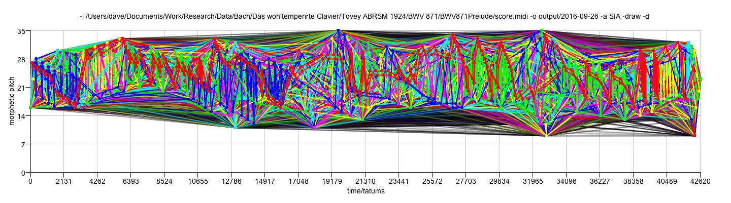
SIA
numberOfNotes 692
compressionRatio 0.002737136053856712
runningTime 1021
encodingLength 252819
numberOfTECs 13947
isDiatonic true

Slide 9
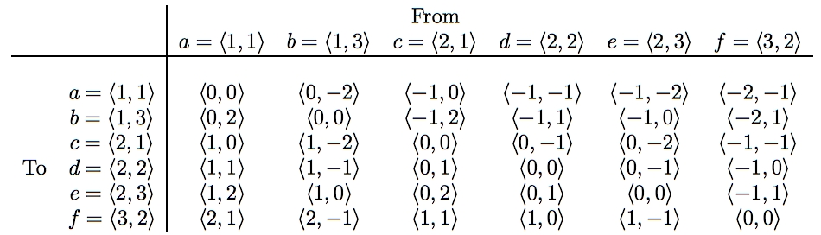
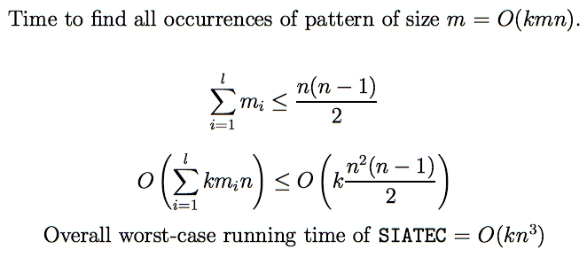
SIATEC - Discovering all occurrences of all MTPs
Translational Equivalence Class (TEC) is set of all translationally invariant occurrences of a pattern
Notes:
SIA only finds one occurrence of each MTP and one vector by which that MTP is translatable within the dataset.
SIATEC, on the other hand, finds all the MTPs using a slightly modified version of SIA and then finds all the vectors by which each MTP is translatable within the dataset.
In other words, it finds all the non-empty MTPs and then all the patterns within the dataset that are translationally equivalent to each MTP.
In SIA, we only needed to compute the vector from each point to every lexicographically greater point because the MTP for a particular vector -v is the same as the pattern that you get by translating the MTP for v by v itself.
However, in this simple implementation of SIATEC, we can find all the occurrences more efficiently by computing all the interpoint vectors and storing them in a table like this one here.
If the points in the dataset are sorted into lexicographical order first, then the vectors in this table increase lexicographically as you descend a column and go from right to left along a row.
Each column contains all the vectors by which the point at the top of the column is translatable within the dataset.
Therefore the set of vectors by which a given pattern in the dataset is translatable is equal to the intersection of the columns headed by the points in that pattern. For example, the pattern {a,c} is translatable within this dataset by the intersection of the columns for which a and c are the original points.
By exploiting the orderedness of this table, we can find all the occurrences of a k-dimensional pattern of size m in a dataset of size n in a worst case running time of O(kmn).
Now, all the MTPs in a dataset can be found by reading through the list of sorted vectors generated by SIA so we know that sum of the cardinalities of the MTPs is less than or equal to n(n-1)/2.
Therefore the worst case time complexity of this implementation of SIATEC is [as shown] which implies that it is O(kn^3).
And, obviously, it uses O(kn^2) space.

Slide 10
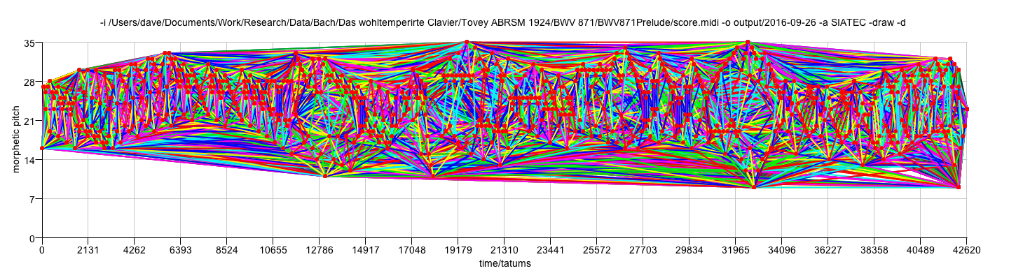
SIATEC
numberOfNotes 692
compressionRatio 0.0024844809696656363
runningTime 3401
encodingLength 278529
encodingLengthWithoutResidualPointSet 278529
numberOfTECs 13079
isDiatonic true

Slide 11
COSIATEC
Start
Dataset
SIATEC
List of <Pattern, Translator_set> pairs
Add best TEC, <P,V> to encoding
Remove points covered by <P,V> from dataset
Is dataset empty?
No
Yes
Output encoding
Notes:
We can use SIATEC together with the heuristics I’ve just described to construct a simple compression algorithm which I call COSIATEC. COSIATEC works like this.
First we use SIATEC to generate a list of <Pattern, Translator_set> pairs in which each pattern is an MTP and each translator set contains all the non-zero vectors by which the pattern is translatable within the dataset. This generally gives a more efficient representation of the set of points covered by the occurrences of a pattern.
Then we can use the heuristics I’ve just described - compression ratio, coverage and compactness - to choose the “best” pattern P and this pattern is printed out together with its translator set.
Then all the points covered by P and its occurrences are removed from the dataset.
Then if the dataset is empty, we end; otherwise, we again run SIATEC on the remaining points in the dataset.
The result is a print out of the “best” pattern and its translators for each iteration of the cycle and this printout is usually a compressed representation of the input dataset.
Obviously, the degree of compression achieved depends on the amount of repetition in the dataset.

Slide 12
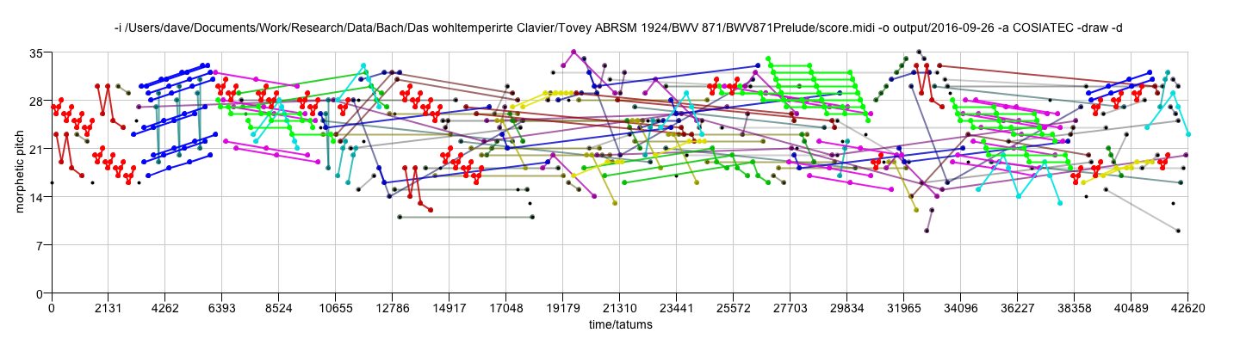
COSIATEC
numberOfNotes 692
compressionRatio 2.276315789473684
runningTime 13813
encodingLength 304
encodingLengthWithoutResidualPointSet 279
numberOfResidualPoints 25
percentageOfResidualPoints 3.61271676300578
compressionRatioWithoutResidualPointSet 2.390681003584229
numberOfTECs 37

Slide 13
SIATECCompress
Adds a TEC to encoding if its <P,Θ> representation is shorter than the set of new points covered

Slide 14
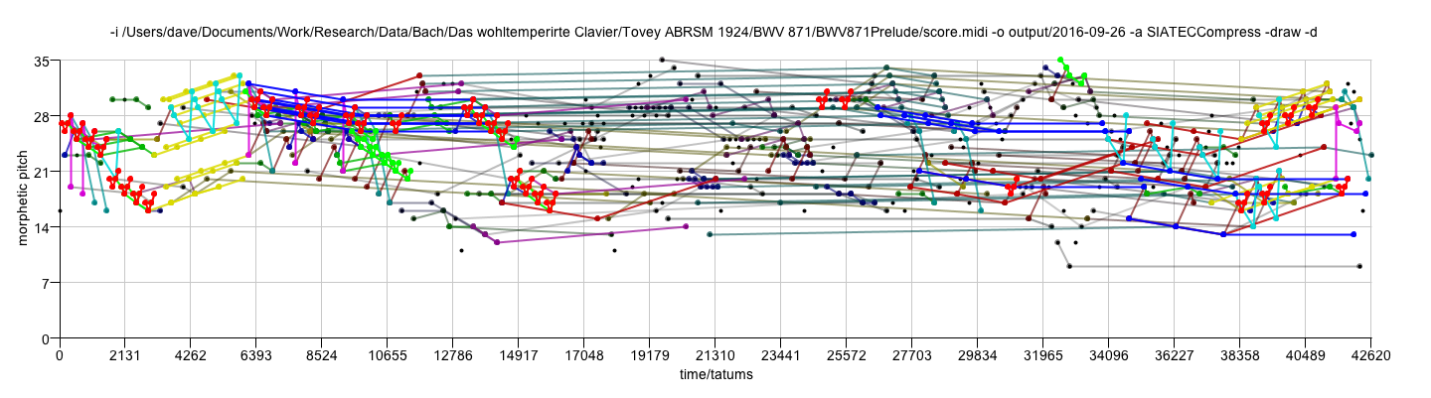
SIATECCompress
numberOfNotes 692
compressionRatio 1.3568627450980393
runningTime 7271
encodingLength 510
encodingLengthWithoutResidualPointSet 422
numberOfResidualPoints 88
percentageOfResidualPoints 12.716763005780347
compressionRatioWithoutResidualPointSet 1.4312796208530805
numberOfTECs 29
isDiatonic true

Slide 15
Forth’s algorithm
(Forth 2012, Forth and Wiggins 2009)

Slide 16
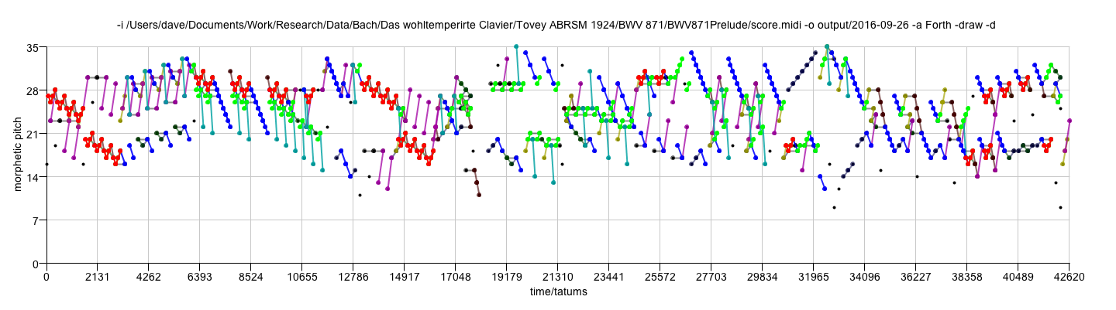
Forth
numberOfNotes 692
compressionRatio 0.9153439153439153
runningTime 4842
encodingLength 756
encodingLengthWithoutResidualPointSet 726
numberOfResidualPoints 30
percentageOfResidualPoints 4.335260115606936
compressionRatioWithoutResidualPointSet 0.9118457300275482
numberOfTECs 11
isDiatonic true

Slide 17
Switches on Forth’s algorithm
-crlow Minimum compression ratio in Forth's algorithm. Default is 0.2.
-crhi Maximum compression ratio in Forth's algorithm. Default is 1.0.
-comlow Minimum compactness threshold in Forth's algorithm. Default is 0.2
-comhi Maximum compactness threshold in Forth's algorithm. Default is 1,0
-cmin c_min threshold in Forth's algorithm. Default is 15
-sigmin sigma_min threshold in Forth's algorithm. Default is 0.5.
-bbcomp If present, use bounding-box compactness in Forth's algorithm instead of within-voice segment compactness.

Slide 18
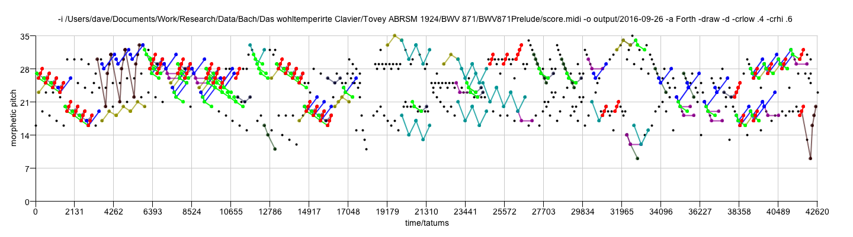
Forth with crlow = 0.4, crhi = 0.6
numberOfNotes 692
compressionRatio 1.291044776119403
runningTime 5205
encodingLength 536
encodingLengthWithoutResidualPointSet 241
numberOfResidualPoints 295
percentageOfResidualPoints 42.630057803468205
compressionRatioWithoutResidualPointSet 1.6473029045643153
numberOfTECs 10
isDiatonic true

Slide 19
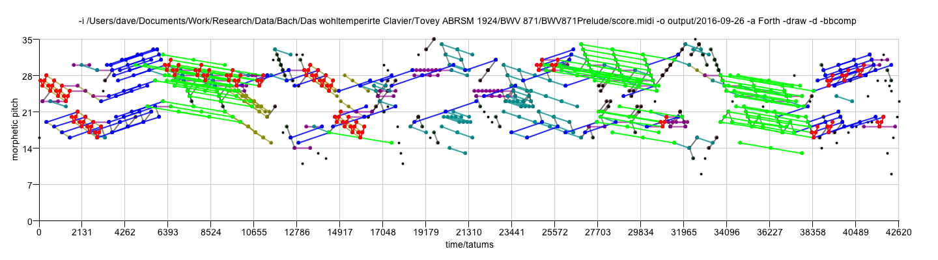
Forth with bbcomp
numberOfNotes 692
compressionRatio 1.0581039755351682
runningTime 4571
encodingLength 654
encodingLengthWithoutResidualPointSet 607
numberOfResidualPoints 47
percentageOfResidualPoints 6.791907514450867
compressionRatioWithoutResidualPointSet 1.0626029654036244
numberOfTECs 9
isDiatonic true

Slide 20
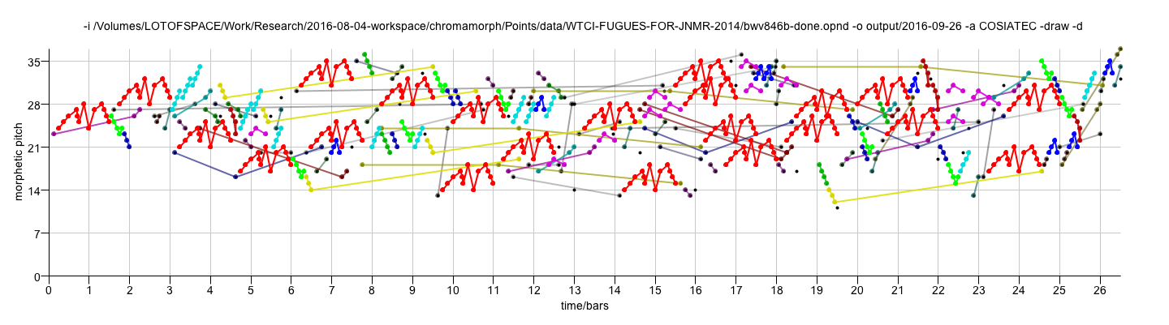
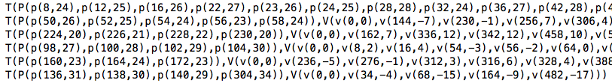
RecurSIA with COSIATEC
COSIATEC
RecurSIA with COSIATEC

Slide 21
RecurSIA with COSIATEC
COSIATEC
numberOfNotes 729
compressionRatio 2.904
runningTime 10026
encodingLength 251
encodingLengthWithoutResidualPointSet 225
numberOfResidualPoints 26
percentageOfResidualPoints 3.566
compressionRatioWithoutResidualPointSet 3.124
numberOfTECs 30
RecurSIA with COSIATEC
numberOfNotes 729
compressionRatio 2.927
runningTime 9846
encodingLength 249
encodingLengthWithoutResidualPointSet 223
numberOfResidualPoints 26
percentageOfResidualPoints 3.566
compressionRatioWithoutResidualPointSet 3.152
numberOfTECs 30

Slide 22
SIACT and SIAR
(Collins et al. 2010, Collins 2011)

Slide 23
Collins et al.’s Compactness Trawler
-ct If present, uses Collins' compactness trawler, as used in his SIACT and SIARCT-CFP algorithms.
-cta The variable which Collins et al call 'a'. It is the minimum compactness permitted in the trawled patterns.
-ctb The variable which Collins et al call 'b'. It is the minimum size of the patterns trawled by the compactness trawler.

Slide 24
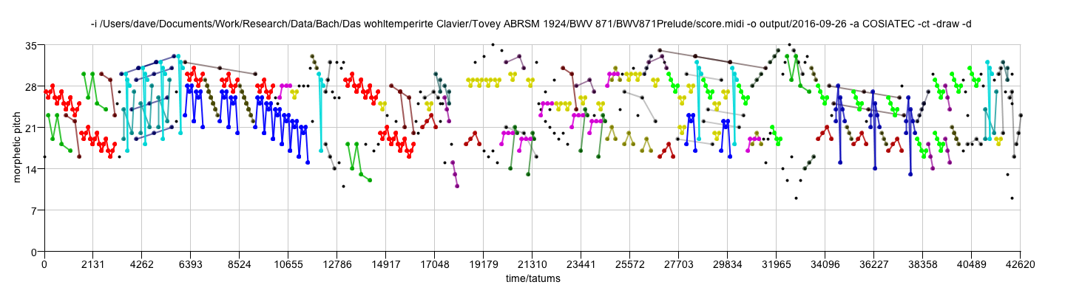
COSIATEC with CT
numberOfNotes 692
compressionRatio 2.096969696969697
runningTime 3865
encodingLength 330
encodingLengthWithoutResidualPointSet 238
numberOfResidualPoints 92
percentageOfResidualPoints 13.294797687861271
compressionRatioWithoutResidualPointSet 2.5210084033613445
numberOfTECs 28
isDiatonic true

Slide 25
Collins’ SIAR algorithm
-rsd If present, limits SIA to r superdiagonals, as used in Collins' SIAR algorithm. Number of superdiagonals determined by the –r switch.
-r Number of superdiagonals to analyse if limited with -rsd switch. Default value is 1.

Slide 26
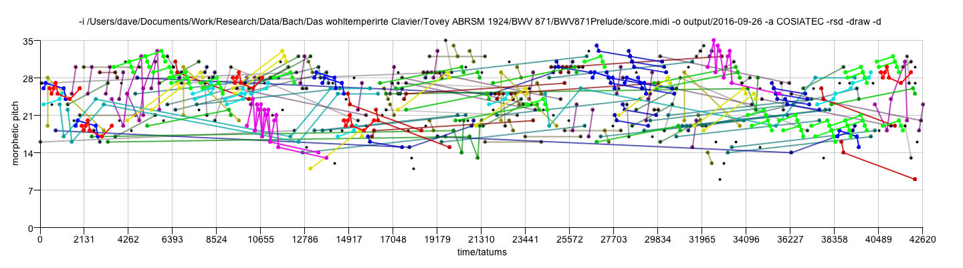
COSIATEC with SIAR
numberOfNotes 692
compressionRatio 1.9329608938547487
runningTime 7831
encodingLength 358
encodingLengthWithoutResidualPointSet 301
numberOfResidualPoints 57
percentageOfResidualPoints 8.236994219653178
compressionRatioWithoutResidualPointSet 2.1096345514950166
numberOfTECs 35
isDiatonic true

Slide 27
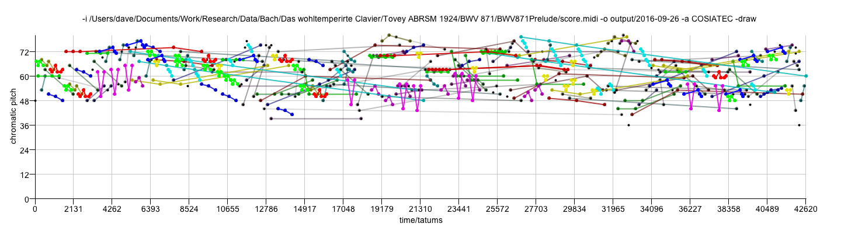
Chromatic or morphetic pitch
-d If present, then use morphetic (diatonic) pitch instead of chromatic pitch. If morphetic pitch is not available in the input data (e.g., MIDI format), then input data is pitch-spelt using the PS13s1 algorithm.

Slide 28
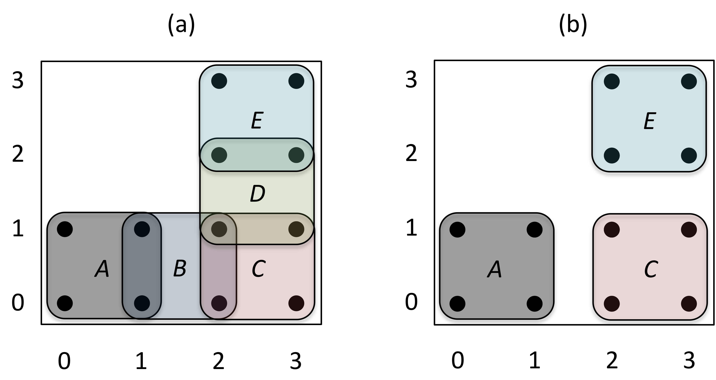
Removing redundant translators
-rrt If present, redundant translators are removed.

Slide 29
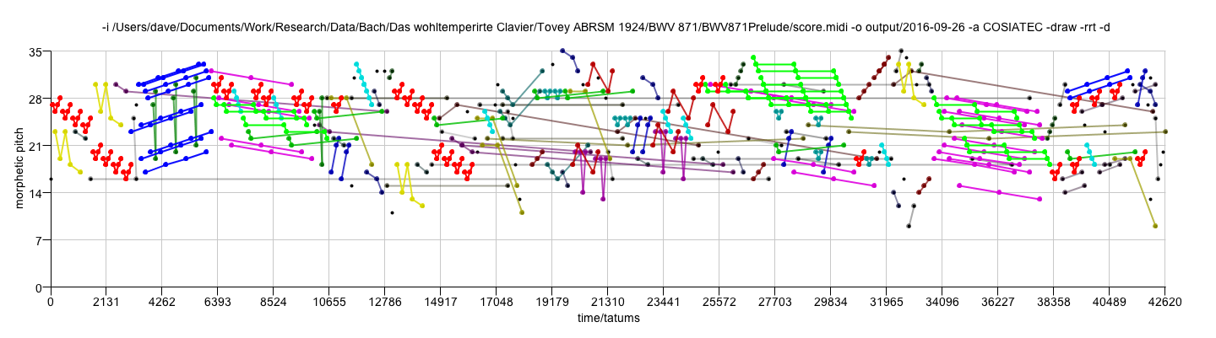
COSIATEC with -rrt
numberOfNotes 692
compressionRatio 2.3221476510067114
runningTime 14443
encodingLength 298
encodingLengthWithoutResidualPointSet 265
numberOfResidualPoints 33
percentageOfResidualPoints 4.76878612716763
compressionRatioWithoutResidualPointSet 2.486792452830189
numberOfTECs 32
outputFileExtension cos
isDiatonic true

Slide 30
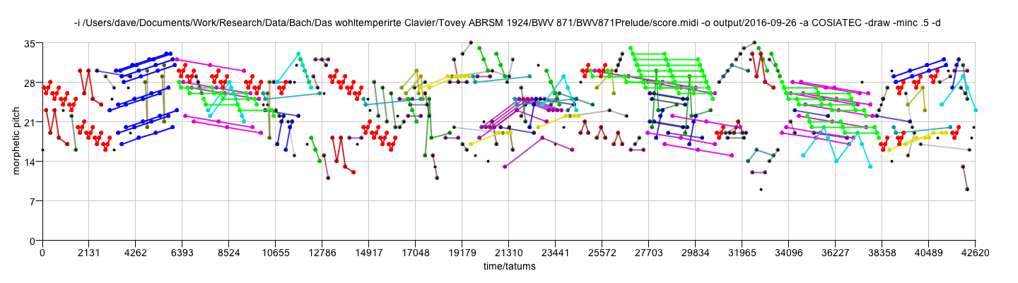
Minimum compactness
-minc Threshold value for minimum TEC compactness (default is 0.0).

Slide 31
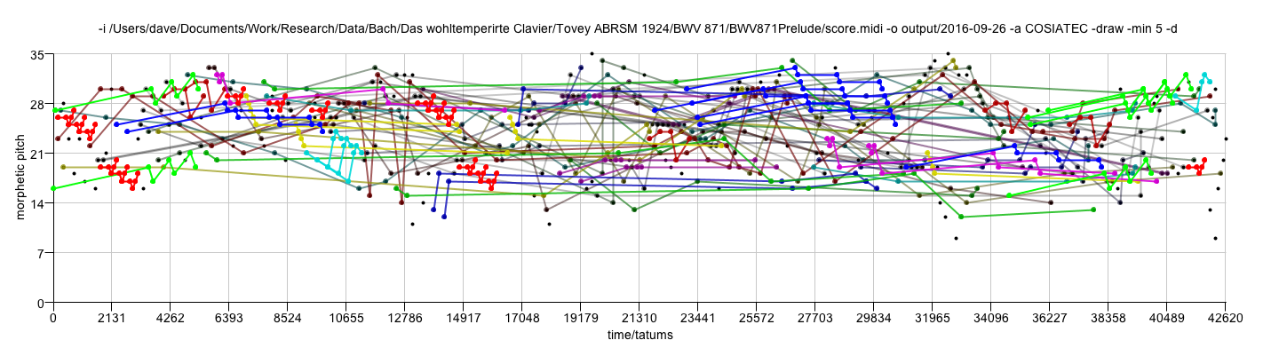
Controlling pattern size
-min Minimum allowed pattern size. Default is 0.
-max Maximum allowed pattern size. Default is 0, which means that patterns of all sizes are allowed.

Slide 32
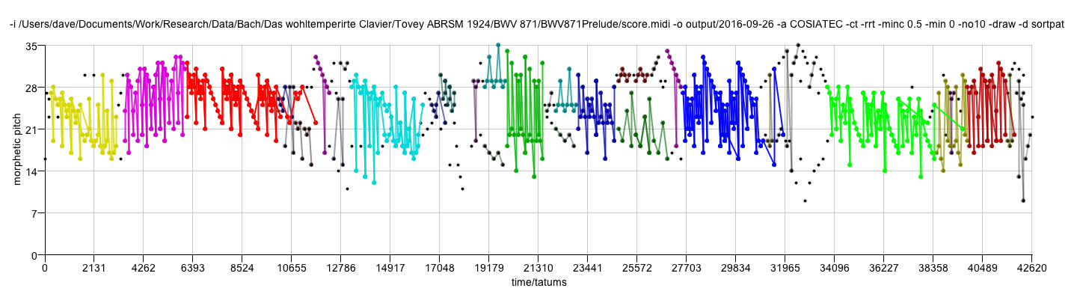
Sorting TECs with priority given to pattern size
-sortpat When using COSIATEC, getBestTEC sorts TECs with preference given to TECs with larger patterns.

