Slide 1
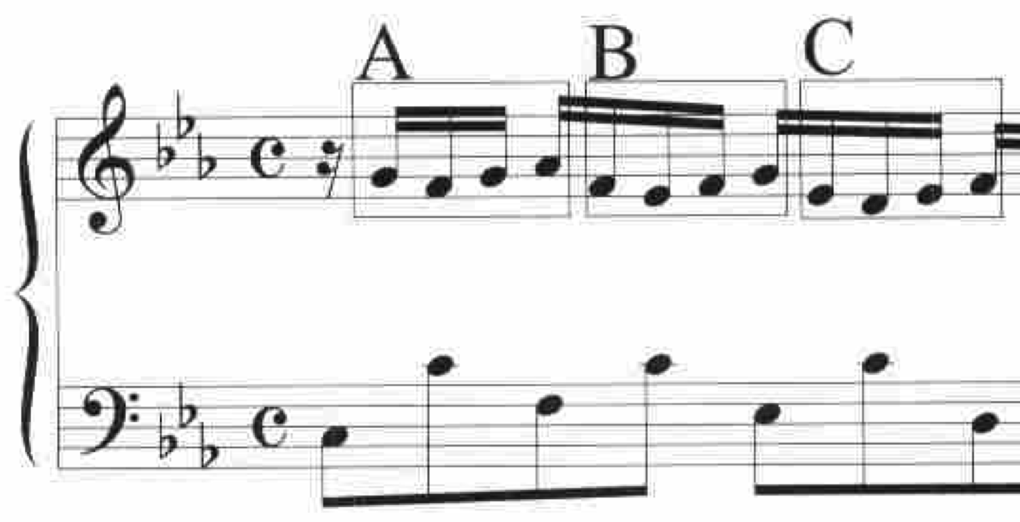
Music Analysis and
Kolmogorov Complexity
P(p(1,27),p(2,26),p(3,27),p(4,28),p(5,26),p(6,25),p(7,26),p(8,27),p(9,25),p(10,24),p(11,25),p(12,26))
t(P(p(1,27),p(5,26),p(9,25)),V(v(1,-1),v(2,0),v(3,1)))
David Meredith
dave@create.aau.dk
Department of Architecture, Design and Media Technology
Aalborg University
Denmark
XIX CIM, Trieste, 21-24 November 2012

Slide 2
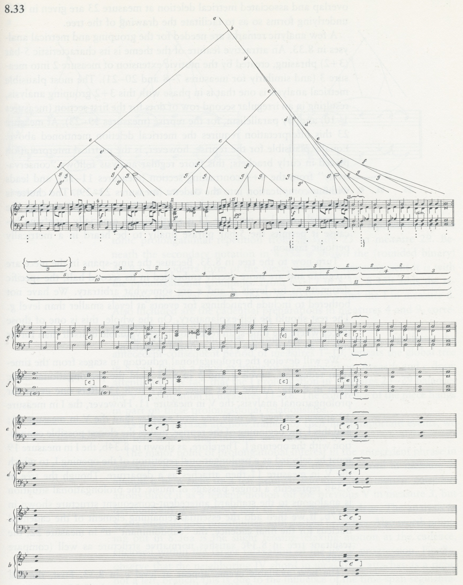
The goal of music analysis
The goal of music analysis is to find the most satisfying explanations for musical works
The “most satisfying” explanation for a musical work is usually one that
  is as simple as possible
  accounts for as much detail as possible
These two criteria often conflict
Lerdahl and Jackendoff (1983, p.205)

Slide 3
A musical analysis as a program
A musical analysis can be represented as a computer program or algorithm
  The program must generate a representation of the music to be explained as its only output
The program is usually a compact or compressed encoding of its output
The program is an explanation of its output
Meredith, ISMIR 2012
Notes:
Some notes
----- Meeting Notes (08/11/2012 15:10) -----
Some meeting notes

Slide 4
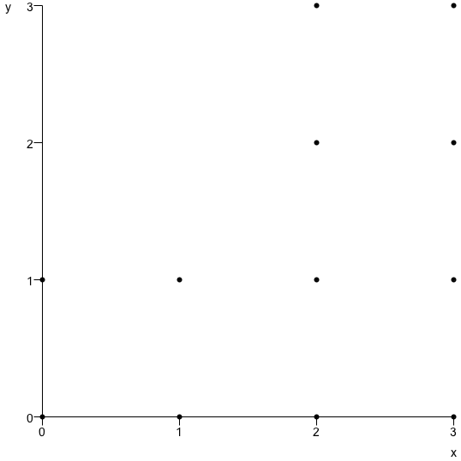
Program length as a measure of complexity
P(p(0,0),p(0,1),p(1,0),p(1,1),p(2,0),p(2,1),p(2,2),p(2,3),p(3,0),p(3,1),p(3,2),p(3,3))
t(P(p(0,0),p(0,1),p(1,0),p(1,1)),V(v(2,0),v(2,2)))
From Kolmogorov complexity theory:
  can use the length of a program to measure the complexity of its corresponding explanation
  The shorter the program, the simpler and better the explanation

Slide 5
Level of detail depends on representation
The level of detail on which the structure of the music is explained depends on the amount of detail represented in the output of the program
The output should be an in extenso description of the music
  e.g., MIDI, audio, MusicXML, MEI, chord sequence
Chord sequence
MIDI
Increasing detail
MusicXML/MEI
Audio

Slide 6
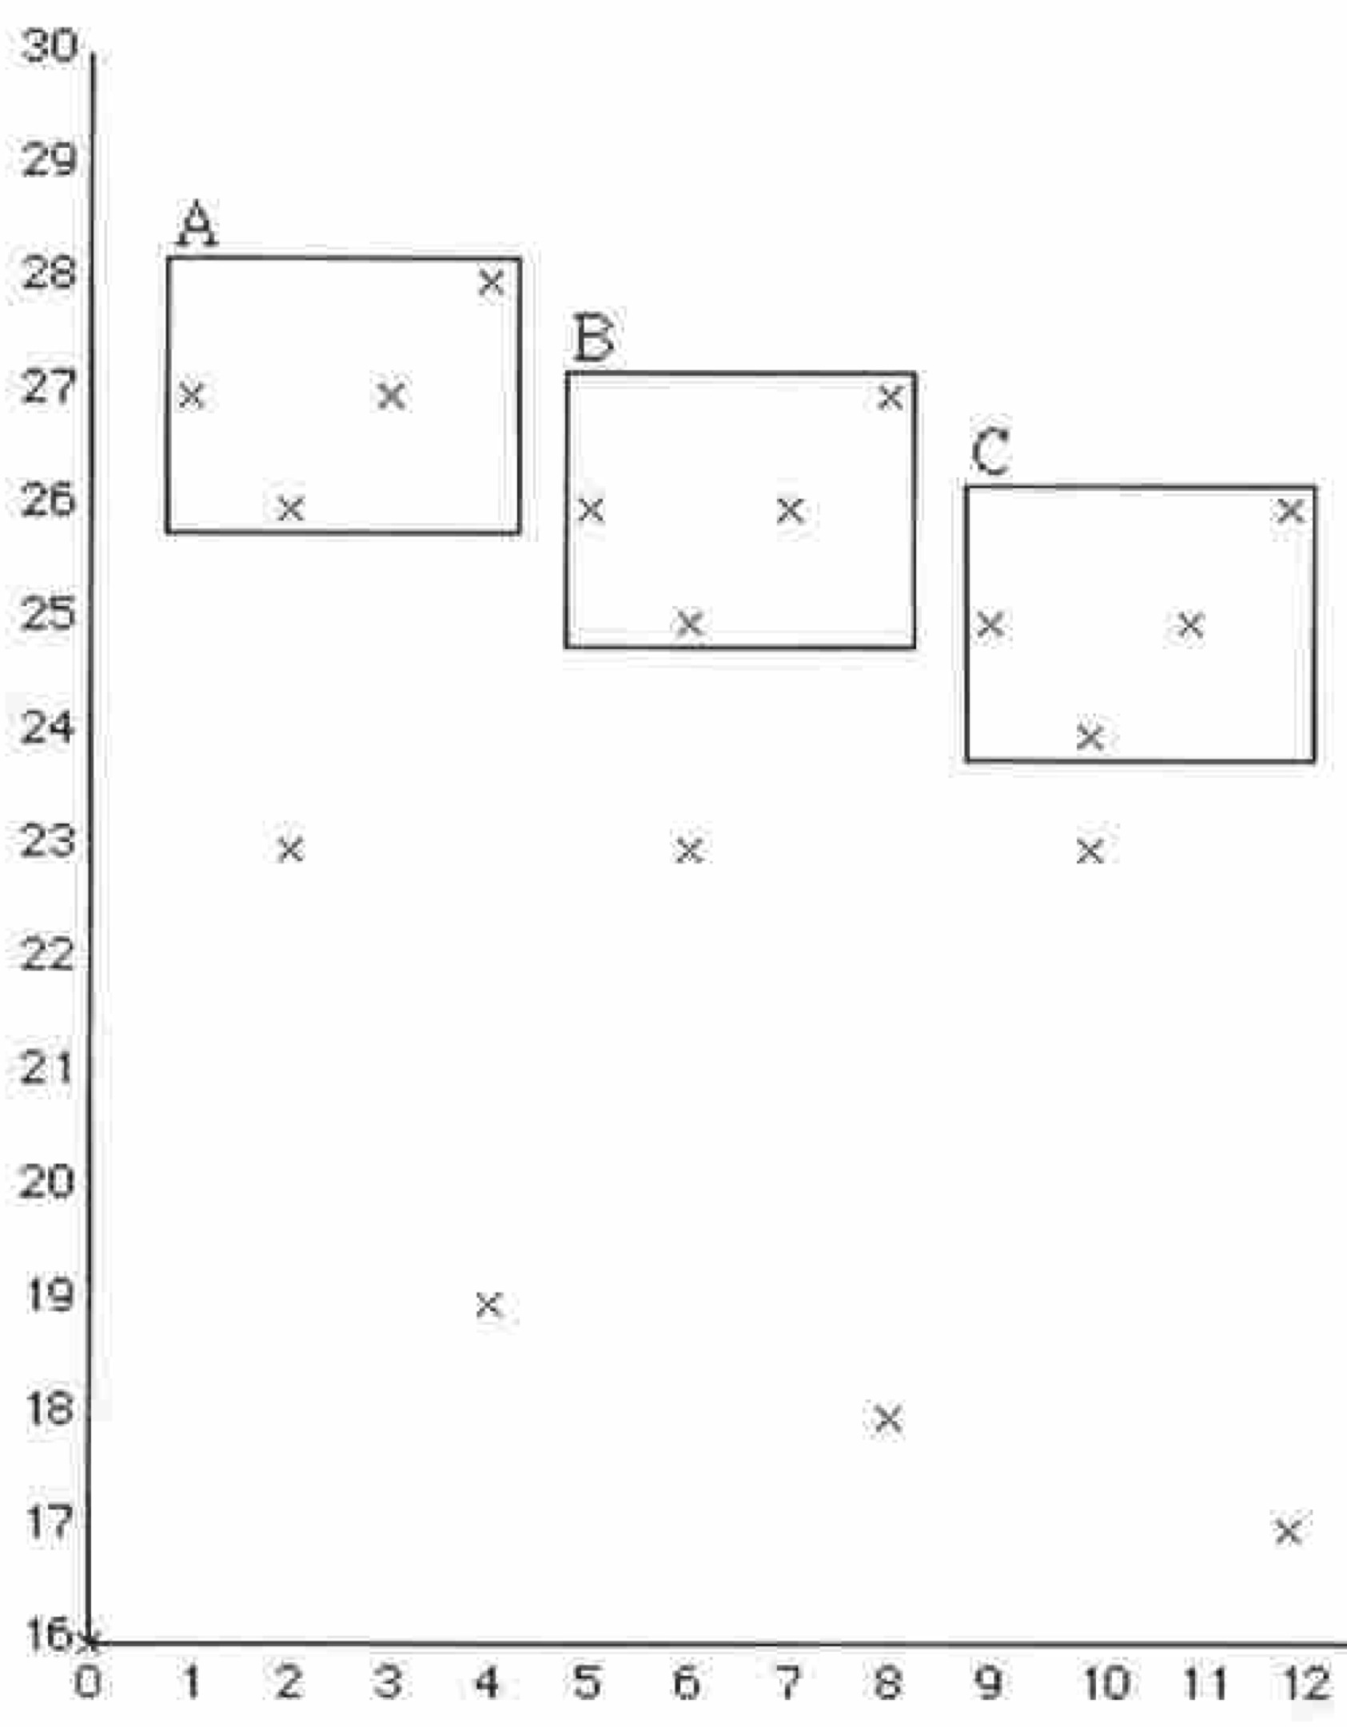
Music analysis aims to compress music
P(p(1,27),p(2,26),p(3,27),p(4,28),p(5,26),p(6,25),p(7,26),p(8,27),p(9,25),p(10,24),p(11,25),p(12,26))
t(P(p(1,27),p(5,26),p(9,25)),V(v(1,-1),v(2,0),v(3,1)))
Since the best explanations are the shortest descriptions, the aim of music analysis is to compress music as much as possible
Meredith, Lemström and Wiggins (2002)

Slide 7
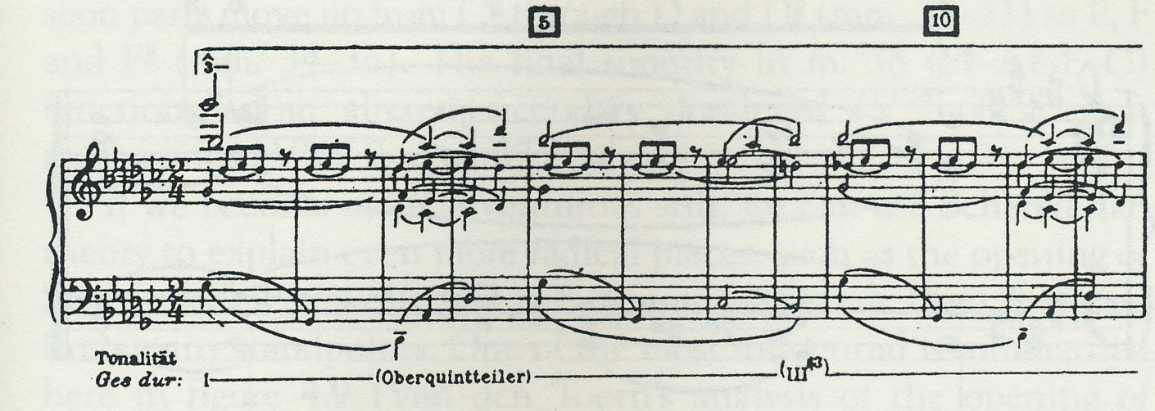
Perceptual organisations of surfaces
Analysis of Chopin Op.10, No.5
Schenker (1925, p.92)
Music analysis aims to find the most satisfying perceptual organisations that are consistent with a musical surface
  could be a score or a performance
Analysis of first bar of Chopin Op.10, No.5
Meredith (2012)

Slide 8
Likelihood vs. Simplicity
Chater (1996, p.571)
Theories of perceptual organisation mostly based on either
  Likelihood principle: Prefer the most probable interpretation (Helmholtz, 1910)
  Simplicity principle: Prefer the simplest interpretation (Koffka, 1935)
Chater (1996) showed that the two principles are mathematically identical
Likelihood
Simplicity

Slide 9
Coding theories
Long tradition in psychology of coding languages designed to represent the structures of patterns in particular domains
  preferred organisations have shortest encodings in the coding language
Coding theories proposed for
  serial patterns (e.g., Simon 1972)
  visual patterns (e.g., Leeuwenberg 1971)
  musical patterns (e.g., Simon and Sumner 1968, Deutsch and Feroe 1981, Meredith 2012)
Simon (1972, p.373)
Leeuwenberg (1971, pp. 317-8)
Deutsch and Feroe (1981, p. 510)

Slide 10
Problems with coding theories
LISP:
(dotimes (j 10) (pprint j))
Chater (1996) identifies 2 problems with coding theories
  Each domain needs its own pattern language
  Length of an encoding depends on the design of the language
C:
#include <stdio.h>
main(){
char i;
for(i = 0; i < 10; i++)
printf("%d\n",i);
}
JAVA:
public class OneToTen {
public static void main(String[] args) {
for(int i = 0; i < 10; i++) System.out.println(i);
}
}

Slide 11
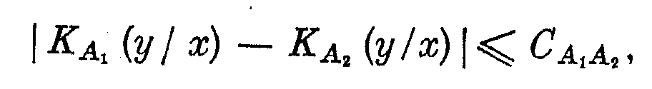
Invariance theorem
Kolmogorov (1965, p.6)
Chater claims these problems can be solved by invoking the invariance theorem
  the shortest description of an object is invariant up to a constant between different universal languages

Slide 12
Universal languages
A universal language is one that is rich enough to express partial recursive functions
All standard computer programming languages are universal languages
  e.g., Java, C, Lisp, etc.

Slide 13
Comparing analyses by comparing programs
Invariance theorem suggests we can compare musical analyses by comparing the lengths of programs that express these analyses
  Programs must be written in the same universal programming language

Slide 14
Effective measure of program length allows for automatic music analysis
If an effective (i.e., automatically calculable) measure for program length can be found, then may be possible to automate search for best analysis of any musical object

Slide 15
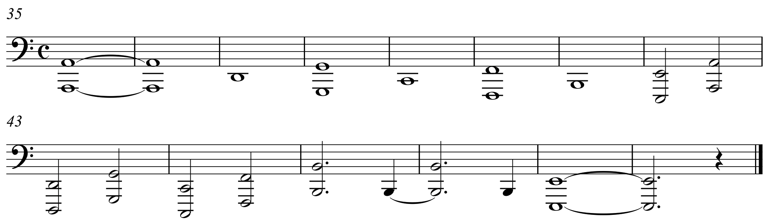
A simple pitch class analysis
Score represents bass part of bars 35 to 48 Chopin’s Étude in C major, Op.10, No.1
Pitch class structure can be represented by the sequence:
  9 2 7 0 5 11 4 9 2 7 0 5 11 4

Slide 16
In extenso encoding of the structure
9 2 7 0 5 11 4 9 2 7 0 5 11 4
Could understand pitch class sequence as 14 unrelated pitch classes
Writing out the sequence in extenso, as shown, represents this way of understanding the structure

Slide 17
A better, shorter interpretation
2(9 2 7 0 5 11 4)
Could understand sequence as two consecutive occurrences of the same 7-element sequence
Requires only 8 independent pieces of information to be remembered
Leads to shorter description
Intuitively a better interpretation or explanation of the sequence

Slide 18
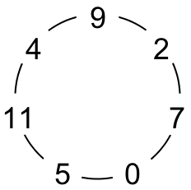
A better explanation?
Sequence can also be understood as two turns around the diatonic fourths cycle in C major
This recognizes structure within each of the two 7-element subsequences
Can be encoded with a single formula

Slide 19
A better explanation?
But this formula requires us to remember
  5 unrelated numbers
  5 unrelated operations
  2 boundary values of i
12 pieces of independent information
  cf. 8 items in 2(9 2 7 0 5 11 4)

Slide 20
A better explanation?
Advantage of using formula becomes apparent when encoding a longer sequence which is not an integer number of full turns around the C major circle of fourths
  e.g.,
    9 2 7 0 5 11 4 9 2 7 0 5 11 4 9 2 7 0 5 11 (20 items)
    p(i) = (((i+2) mod 7) * 5 + 11) mod 12, 0 ≤ i ≤ 19 (12 items)

Slide 21
A better explanation?
  Formula can also be parametrized and reused to describe any sequence of pitch classes formed by circulating around any diatonic fourths cycle
  It provides a highly compressed or compact representation of a very large class of structures that occur often in tonal music

Slide 22
Describing musical structures with programs
9 2 7 0 5 11 4 9 2 7 0 5 11 4
Upper C program literally prints out pitch class sequence
Lower C program uses formula to generate pitch class sequence
Can measure lengths of programs in terms of characters
  ignore line that loads stdio.h
  formatted so that they are as short as possible
Lower program is longer (66 chars) than upper program (48 chars)
  For such a short sequence, doesn’t pay to use more generalized description
#include<stdio.h>
main(){
printf("9 2 7 0 5 11 4 9 2 7 0 5 11 4");
}
#include<stdio.h>
main(){
char i;
for(i=0;i<14;i++)
printf("%d ",(((i+2)%7)*5+11)%12);
}

Slide 23
Get better compression with longer output
9 2 7 0 5 11 4 9 2 7 0 5 11 4 9 2 7 0 5 11 4 9 2 7 0 5 11 4
#include<stdio.h>
main(){
printf("9 2 7 0 5 11 4 9 2 7 0 5 11 4 9 2 7 0 5 11 4 9 2 7 0 5 11 4");
}
#include<stdio.h>
main(){
char i;
for(i=0;i<28;i++)
printf("%d ",(((i+2)%7)*5+11)%12);
}
If cycled 4 times around the C major diatonic fourths circle, then literal program becomes longer (78 chars) than the one that uses the formula (66 chars)
Length of literal program is O(n)
Length of formula-based program is O(1)

Slide 24
Can refactor to get better relative complexity
Can parametrize formula-based program and factor out formula into a function
Allows for very short descriptions of any structure formed by circulating around any diatonic fifths circle given the function definition as “background” knowledge
  e.g., f(5,4,12) generates
  0 5 10 4 9 2 7 0 5 10 4 9
  12 steps around an F major diatonic fourths circle, starting on C
9 2 7 0 5 11 4 9 2 7 0 5 11 4
#include<stdio.h>
f(char k, char s, char l) {
char i;
for(i=0;i<l;i++)
printf("%d ",(((i+s)%7)*5+k+11)%12);
}
main(){
f(0,2,14);
}

Slide 25
Prefer program that gives best compression
The refactored program is longer than the others, but
  function f gives very compact description of an infinite set of structures of a commonly occurring type
  f allows each member of this set to be encoded with a very short description, given the definition of f
Probably therefore considered the “best” description by a software engineer and a music analyst
  But only if structures of this type commonly occur in music
9 2 7 0 5 11 4 9 2 7 0 5 11 4
#include<stdio.h>
f(char k, char s, char l) {
char i;
for(i=0;i<l;i++)
printf("%d ",(((i+s)%7)*5+k+11)%12);
}
main(){
f(0,2,14);
}

Slide 26
Measuring analysis quality by compression ratio
P is a program that generates a musical structure X
P0 is a program that literally prints out X
L(P) and L(P0) are the lengths of P and P0, respectively
Quality of P as an analysis increases with L(P0)/L(P)
This is the compression ratio achieved on X by the encoding P

Slide 27
Measuring program length
So far, we’ve measured program length in terms of number of characters in the most compactly formatted version of the program
This is problematic because user-defined identifier names can be of arbitrary length
Could stipulate that each user-defined identifier only counts as 1 character
But total number of distinct tokens could exceed number of characters

Slide 28
Measuring program length in terms of information
Better way to measure program length is in terms of the number bits required to uniquely identify each token within the total set of tokens used by (or available to) the program
n_{tok} is number of bits required to store a token
  amount of Shannon (1948) information in a token
n_{chr} is number of bits required to store a character
l(n_{i}) is number of bits required to store a particular number

Slide 29
Dependency of program length on language
Length of a program depends on syntactic constructions available in the language
  Programs for symbolic manipulation tend to be shorter in Lisp than in Fortran
  Programs for numerical computation tend to be shorter in Fortran than in Lisp
Problem:
  L₁, L₂ are two programs in Lisp, L₁ shorter than L₂
  F₁, F₂ are two equivalent programs in Fortran
  F₁ may be longer than F₂
If measuring quality by length, then relative quality depends on language

Slide 30
Solutions?
Invariance theorem doesn’t help
  Only says that minimal length description is invariant to within a constant between different universal languages
Could define concrete universal machines and measure program length in terms of bits on these machines
  concrete Kolmogorov complexity
Could return to using custom-designed encoding languages for music
  in the manner of Simon and Sumner (1968), Deutsch and Feroe (1981), Meredith (2012)

Slide 31
Summing up
Propose that musical analyses can be expressed as computer programs that generate representations of musical objects
Can use program length as a measure of analysis quality
Measuring program length is problematic
  Relative length of two programs depends on language
Possible solutions are
  Concrete Kolmogorov complexity
  Custom-designed languages

Slide 32
References
Chater, N. (1996). Reconciling simplicity and likelihood principles in perceptual organization. Psychological Review, 103(3):566-581.
Deutsch, D. and Feroe, J. (1981). The internal representation of pitch sequences in tonal music. Psychological Review, 88(6):503-522.
Koffka, K. (1935). Principles of Gestalt Psychology. Harcourt Brace, New York.
Kolmogorov, A.N. (1965). Three approaches to the quantitative definition of information. Problems of Information Transmission, 1(1):1-7.
Leeuwenberg, E.L.J. (1971). A perceptual coding language for visual and auditory patterns. American Journal of Psychology, 84(3):307-349.
Lerdahl, F. and Jackendoff, R. (1983). A Generative Theory of Tonal Music. MIT Press, Cambridge, MA.
Meredith, D. (2012). A geometric language for representing structure in polyphonic music. Proceedings of the 13th International Society for Music Information Retrieval Conference, Porto, Portugal.
Meredith, D., Lemström, K. and Wiggins. G. A. (2002). Algorithms for discovering repeated patterns in multidimensional representations of polyphonic music. Journal of New Music Research, 31(4):321-345.
Schenker. H. (1925). Das Meisterwerk in der Musik (Vol. 1). Drei Masken Verlag, Munich.
Shannon, C.E. (1948). A mathematical theory of communication. The Bell System Technical Journal, 27(3):379-423.
Simon, H.A. (1972). Complexity and the representation of patterned sequences of symbols. Psychological Review, 79(5):369-382.
Simon, H.A. and Sumner, R.K. (1968). Pattern in music. In Kleinmuntz, B. (ed.), Formal Representation of Human Judgment. Wiley, New York.
von Helmholtz. H. L. F. (1910/1962). Treatise on Physiological Optics. Dover, New York.

