Slide 1
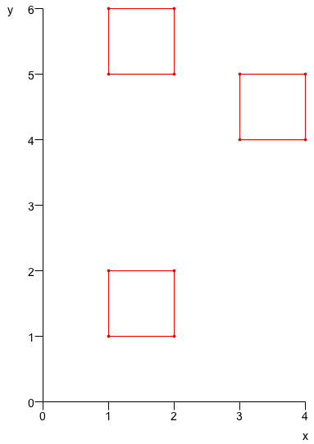
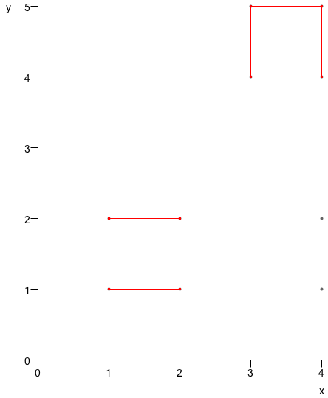
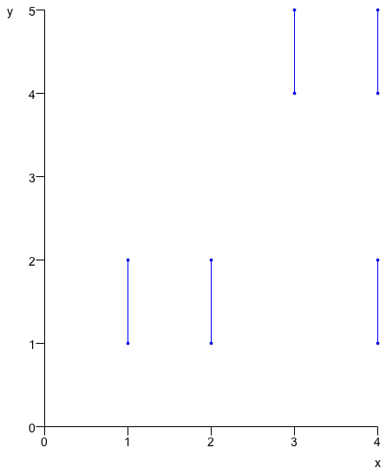
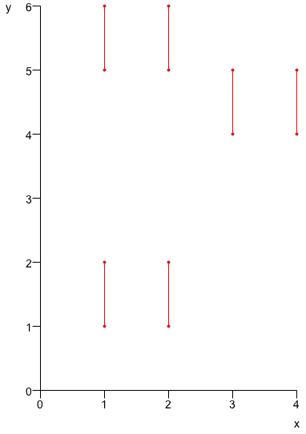
A Compression-Based Model of Musical Learning
David Meredith
DMRN+7, Queen Mary University of London, 18 December 2012

Slide 2
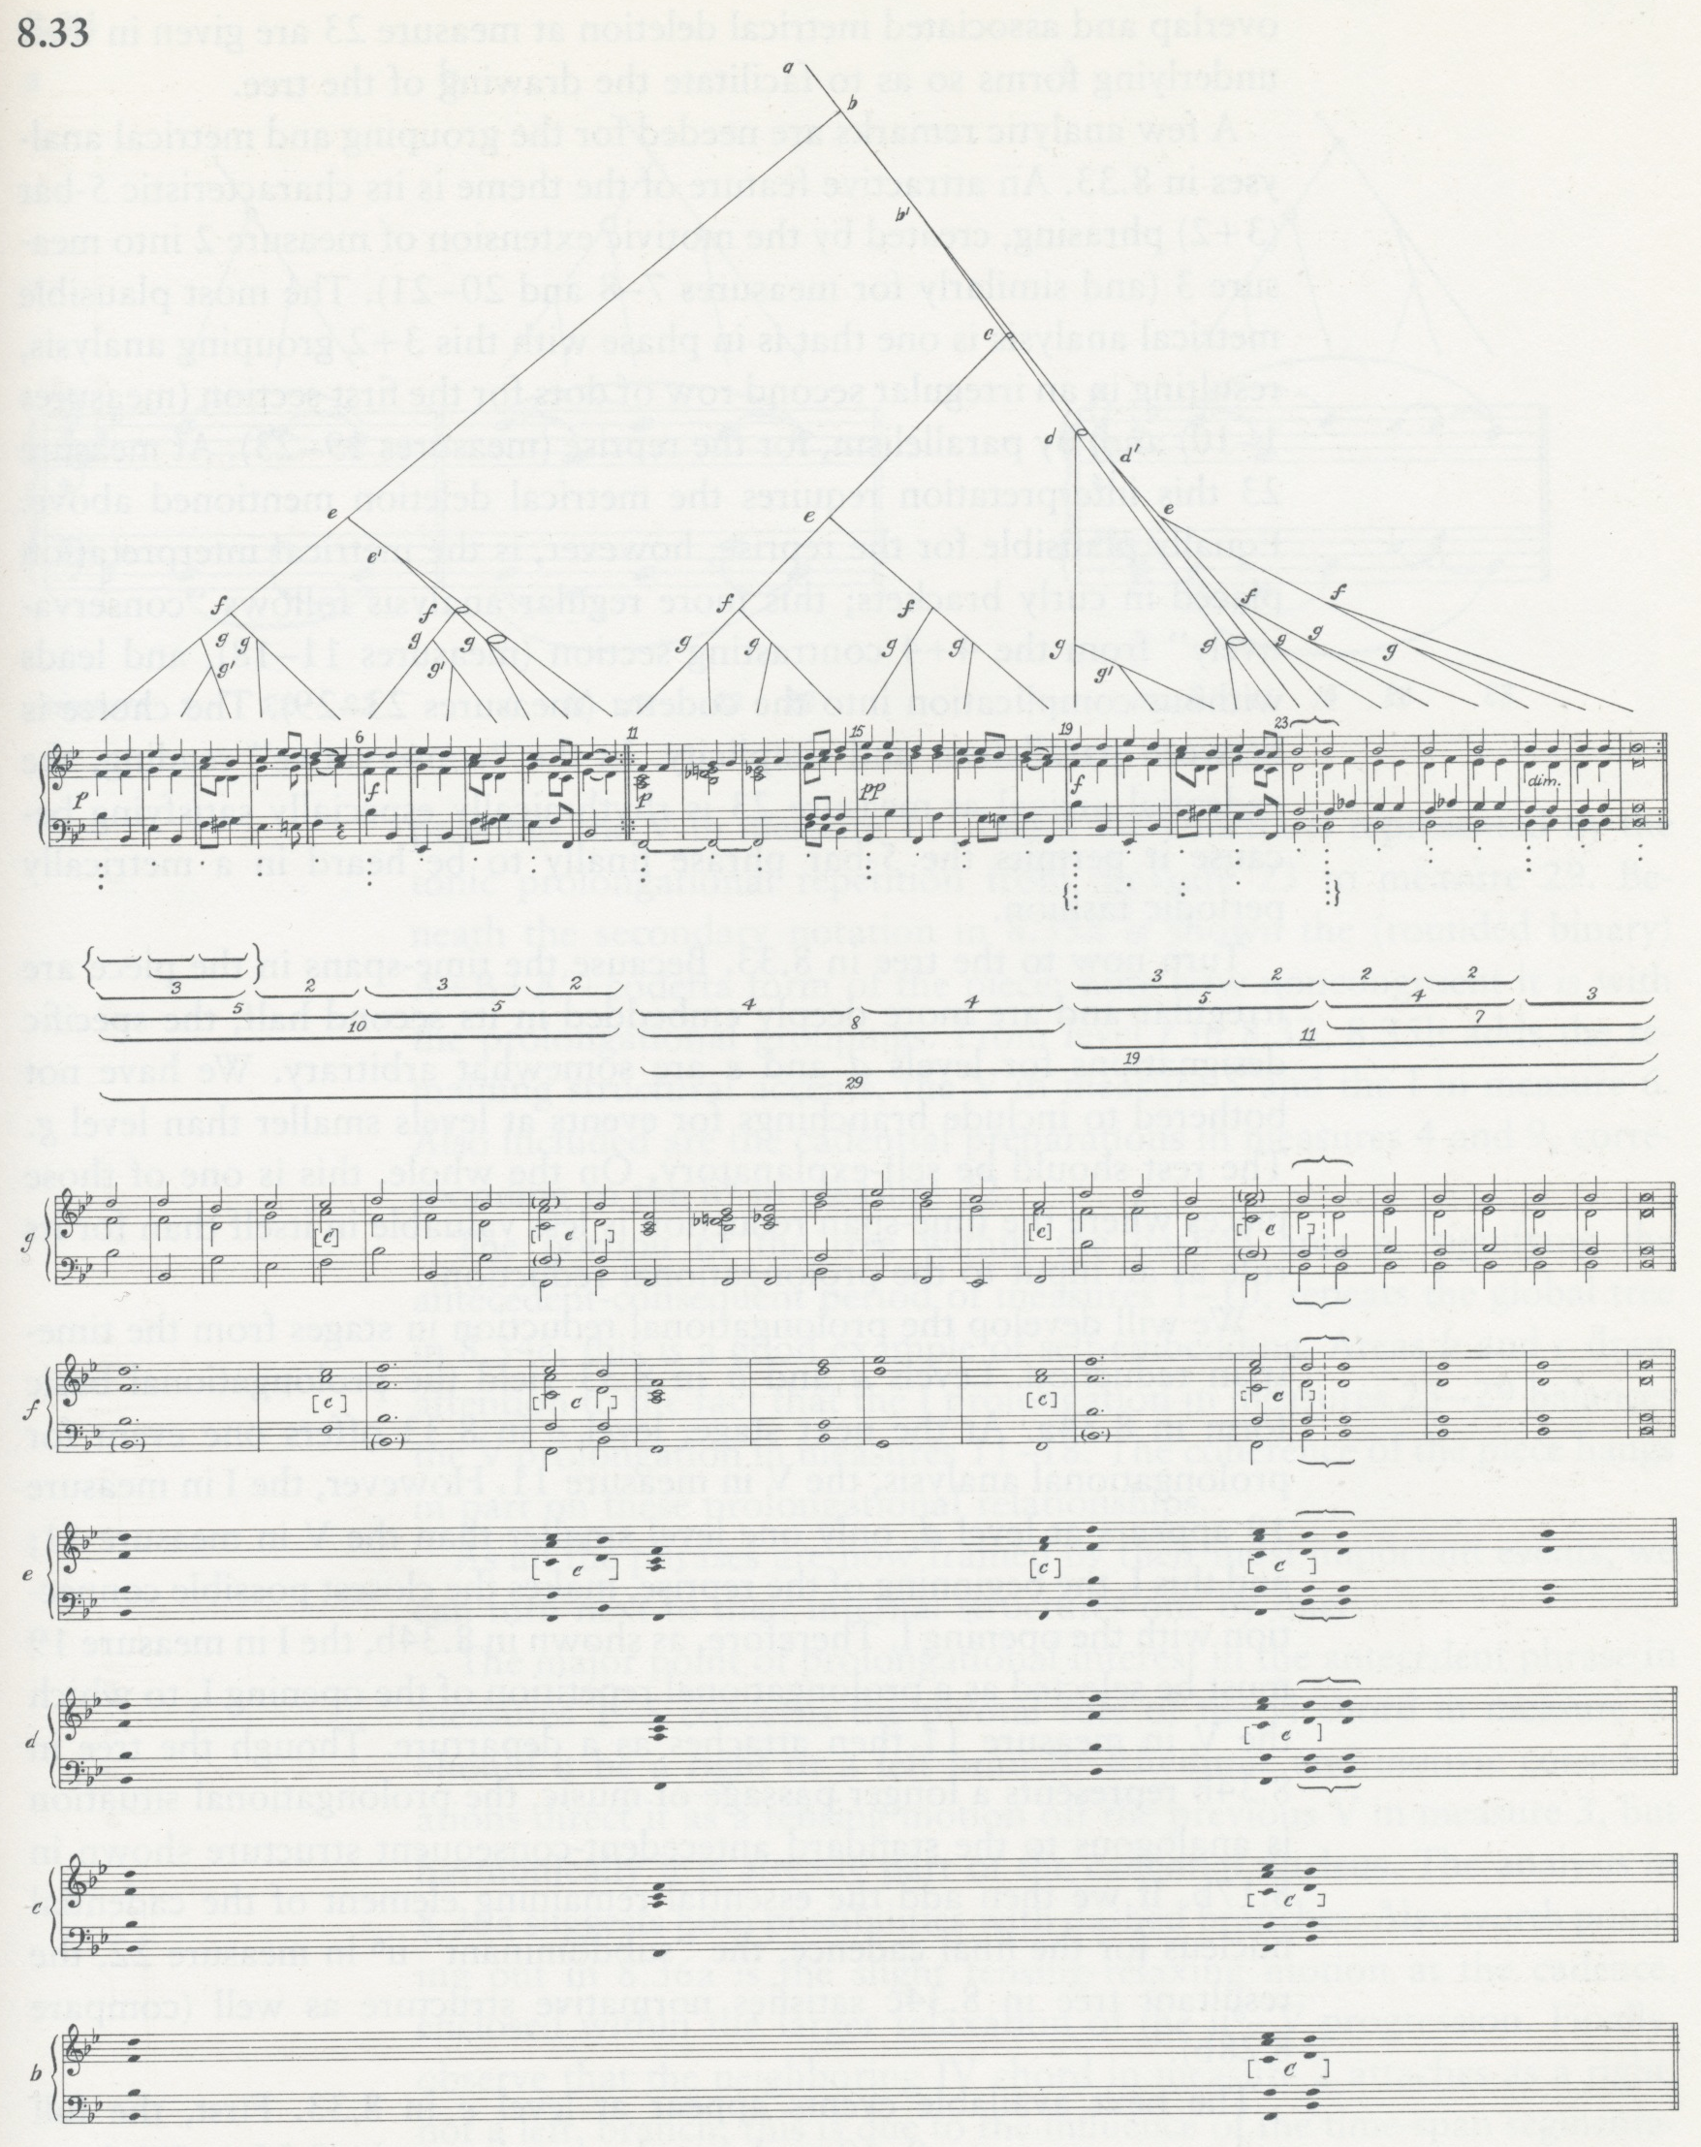
The goal of music analysis
The goal of music analysis is to find the best possible explanations for musical works
The “best possible” explanation for a musical work is one that allows you to
  remember it most easily
  identify errors most accurately
  predict best what will come next
  ...
The best possible explanation
  is as simple as possible
  accounts for as much detail as possible
These two criteria often conflict
Lerdahl and Jackendoff (1983, p.205)

Slide 3
A musical analysis as a program
A musical analysis can be represented as a computer program or algorithm
  The program must generate a representation of the music to be explained as its only output
The program is usually a compact or compressed encoding of its output
The program is a description of its output
If this description is short enough, it becomes an explanation of its output
Meredith (2012)
Notes:
Some notes
----- Meeting Notes (08/11/2012 15:10) -----
Some meeting notes

Slide 4
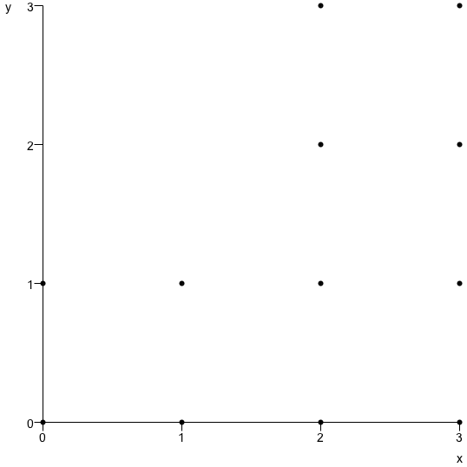
Program length as a measure of complexity
P(p(0,0),p(0,1),p(1,0),p(1,1),p(2,0),p(2,1),p(2,2),p(2,3),p(3,0),p(3,1),p(3,2),p(3,3))
t(P(p(0,0),p(0,1),p(1,0),p(1,1)),V(v(2,0),v(2,2)))
From Kolmogorov (1965) complexity theory:
  can use the length of a program to measure the complexity of its corresponding explanation
  The shorter the program, the simpler and better the explanation

Slide 5
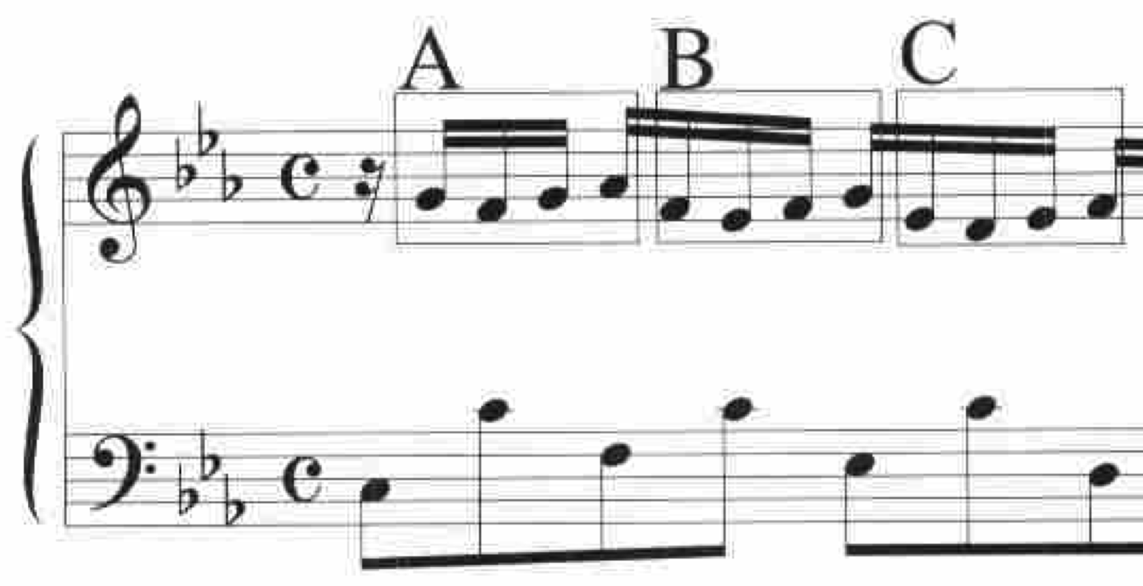
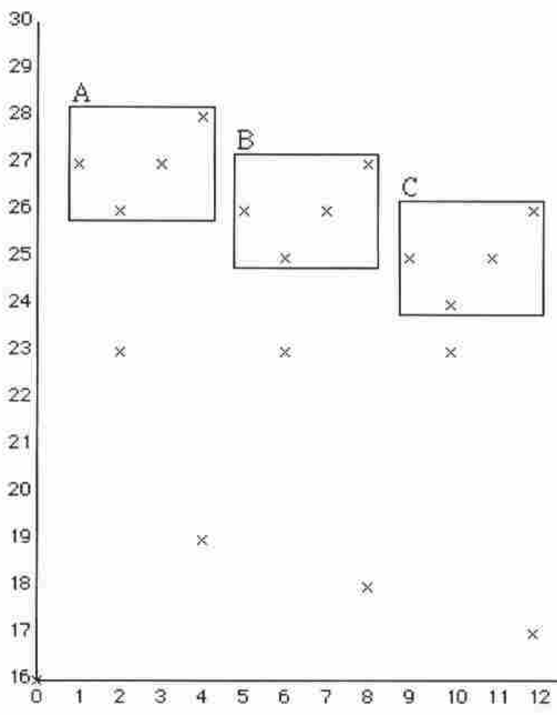
Music analysis aims to compress music
P(p(1,27),p(2,26),p(3,27),p(4,28),p(5,26),p(6,25),p(7,26),p(8,27),p(9,25),p(10,24),p(11,25),p(12,26))
t(P(p(1,27),p(2,26),p(3,27), p(4,28)),V(v(4,-1),v(8,-2)))
Since the best explanations are the shortest descriptions, the aim of music analysis is to compress music as much as possible
Meredith, Lemström and Wiggins (2002)

Slide 6
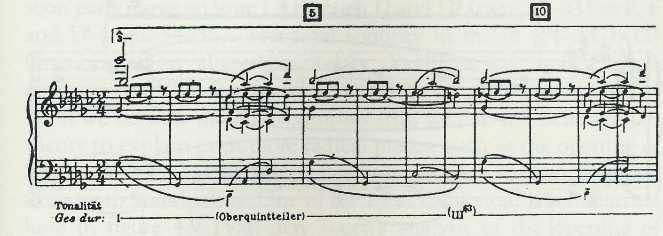
Perceptual organisations of surfaces
Analysis of Chopin Op.10, No.5
Schenker (1925, p.92)
Music analysis aims to find the most satisfying perceptual organisations that are consistent with a musical surface
  could be a score or a performance
Analysis of first bar of Chopin Op.10, No.5
Meredith (2012)

Slide 7
Likelihood vs. Simplicity
Chater (1996, p.571)
Theories of perceptual organisation mostly based on either
  Likelihood principle: Prefer the most probable interpretation (Helmholtz, 1910)
  Simplicity principle: Prefer the simplest interpretation (Koffka, 1935)
Chater (1996) showed that the two principles are mathematically identical
Likelihood
Simplicity

Slide 8
Musical objects are interpreted in the context of larger containing objects
A musical object (phrase, section, movement, work, corpus, ...) is usually interpreted within the context of some larger object that contains it
  e.g., a work is often interpreted in the context of its composer’s other works, or other works in the same genre or form or other works for the same instrument(s)
M
I
T
W
S
P
C
F

Slide 9
Analysts look for short programs that compute collections of musical objects
The analyst tries to find the shortest program that computes a set of in extenso descriptions of
  the object to be explained (the explanandum)
  other objects, related to the explanandum, defining a context within which the explanandum is to be interpreted
P

Slide 10
Listener interprets new music in the context of previously heard music
When the (expert) listener interprets a new piece, the existing explanation (program), P, for all music previously heard is modified (as little as possible), to produce a new program, P', to account for the new music in addition
P
P'

Slide 11
Perceived structure represented by process by which object is generated
Perceived structure of new musical object represented by specific way in which P' computes that object
On this view, both music analysis and music perception are the compression of collections of musical objects
P
P'

Slide 12
Perception and analysis are non-optimal compression
Both analyst and (expert) listener aim to find shortest encodings
Neither analyst nor listener achieve this aim in general
Hampered by limitations of perceptual system
    e.g., require recognizable patterns to be fairly compact in pitch-time space (Collins et al., 2011)

Slide 13
Individual differences depend on order of presentation of context
Prefer to re-use previous encodings wherever possible
  “greedy algorithm”: means that way in which a new object is understood depends on the order of presentation of previous objects
Implies that each individual will have a different interpretation of the same musical object that depends, not only on what previous music has been heard, but also the order in which it was encountered

Slide 14
Simple example using SIATECLearn

Slide 15
Simple example using SIATECLearn

Slide 16
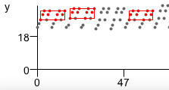


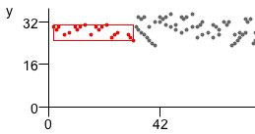
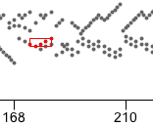
WTC I – Top-ranked patterns
Cover
Learn
BWV 846a
BWV 846b
BWV 847a
BWV 847b

Slide 17
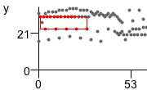


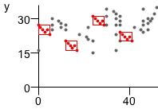
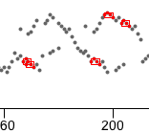


WTC I - Top-ranked patterns
Cover
Learn
BWV 848a
BWV 848b
BWV 849a
BWV 849b

Slide 18
Summary
Main claim is that both music analysis and music perception can be thought of as having the goal of compressing music
A non-optimal, greedy compression strategy which maximises reuse of existing encodings provides an explanation for individual differences in interpretation
A computational model based on the geometric, SIATEC pattern discovery algorithm has been adapted to implement a very simple version of this general idea and applied to Bach’s WTC I
  Results are promising, but output needs to be studied in more depth to determine its significance

Slide 19
Links
Slides can be downloaded from
  http://www.titanmusic.com/papers.php
SIATECCover source code
  http://tinyurl.com/cbrorn7
SIATECLearn source code
  http://tinyurl.com/d78huwo

Slide 20
References
Chater, N. (1996). Reconciling simplicity and likelihood principles in perceptual organization. Psychological Review, 103(3):566-581.
Collins, T., Laney, R., Willis, A. and Garthwaite, P. H. (2011). Modeling pattern importance in Chopin’s Mazurkas. Music Perception, 28(4):387-414.
Koffka, K. (1935). Principles of Gestalt Psychology. Harcourt Brace, New York.
Kolmogorov, A.N. (1965). Three approaches to the quantitative definition of information. Problems of Information Transmission, 1(1):1-7.
Lerdahl, F. and Jackendoff, R. (1983). A Generative Theory of Tonal Music. MIT Press, Cambridge, MA.
Meredith, D. (2012). A geometric language for representing structure in polyphonic music. Proceedings of the 13th International Society for Music Information Retrieval Conference, Porto, Portugal.
Meredith, D., Lemström, K. and Wiggins. G. A. (2002). Algorithms for discovering repeated patterns in multidimensional representations of polyphonic music. Journal of New Music Research, 31(4):321-345.
Schenker. H. (1925). Das Meisterwerk in der Musik (Vol. 1). Drei Masken Verlag, Munich.
von Helmholtz. H. L. F. (1910/1962). Treatise on Physiological Optics. Dover, New York.

