Slide 1
CriticalEd
A Tool for Assisting with the Creation of Critical Commentaries
Caspar M. Kjellberg (Aalborg Universitet)
Axel Teich Geertinger (Det Kongelige Bibliotek Copenhagen)
Sigfrid Lundberg (Det Kongelige Bibliotek Copenhagen)
David Meredith (Aalborg Universitet)

Slide 2
Project Motivation
At the Danish Centre for Music Publication (DCM), they create critical editions of Danish historical works, e.g. Carl Nielsen’s works.
The staff expressed a desire for a tool which would help them ensure consistency between the Emendations and Variant Readings part of the critical apparatus and the final score, since the current proof-reading work flow was error-prone and frustrating.

Slide 3
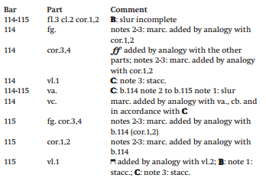
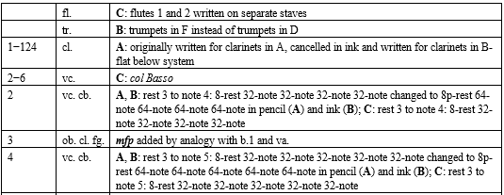
Current Work Flow at DCM
Upon identifying a variant reading or making an emendation to the final score, a descriptive comment is added to the associated Word document – which has to be sorted by bar and instrument. (1000+ comments for an orchestral work)

Slide 4
DCM Requirements
The staff at DCM formulated a set of features, which the tool would need to have, if they were to implement it.
Inputting comments for the score directly from the notation software.
Jumping back and forth between score and comment list, highlighting the currently selected comment. It must be possible to hide the comments.
Associating and embedding music examples with each comment.
Generating a document from the comment list mark-up, which would be suitable for sending to their layout house. (who work in Adobe InDesign).

Slide 5
Project Constraints
DCM uses Sibelius 6 when creating their scores, so any software-based solution to the problem would have to extend its functionality by adding a separate layer.
Initially, a solution using only Manuscript 6 was investigated, but due to limitations inherent to the scripting language, this was dismissed early on. Especially the lack of event handling was a problem. It does, however, support mapping keyboard shortcuts to plug-ins…

Slide 6
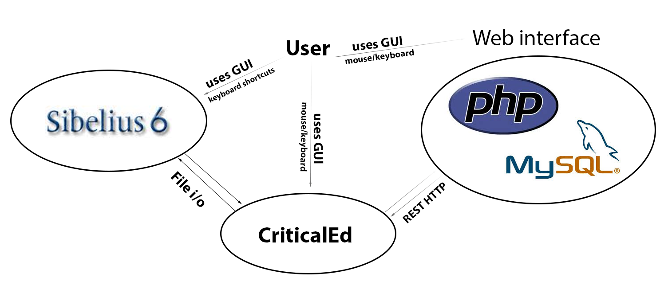
The CriticalEd System

Slide 7
Environment Choices
An open-source, cross-platform design philosophy was chosen, in order to support Windows, Linux and OS X.
Web interface was based on standard XAMPP distribution and was written in PHP.
Helper application was written in C++ using Jules’ Utility Class Extensions, a GPL-licensed, cross-platform library.
All data passed around in XML format.

Slide 8
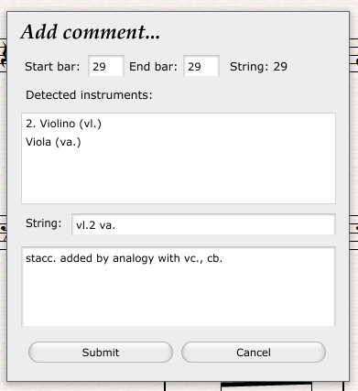
1: Adding Comments from Sibelius
Selection is made.
Comma key pressed, dialog pops up in front of Sibelius.
Data is entered. (bar and instrument data is automatically filled in)
Comment is saved to the database.

Slide 9
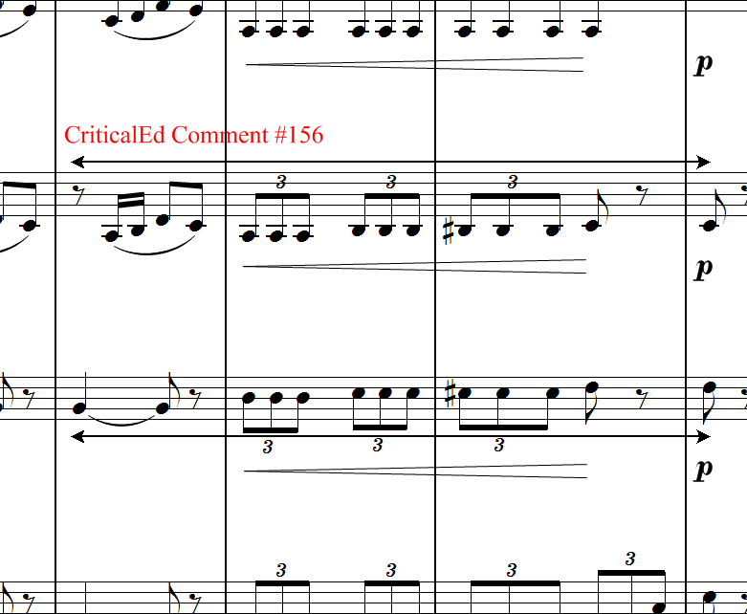
2: In-score Comment Indication

Slide 10
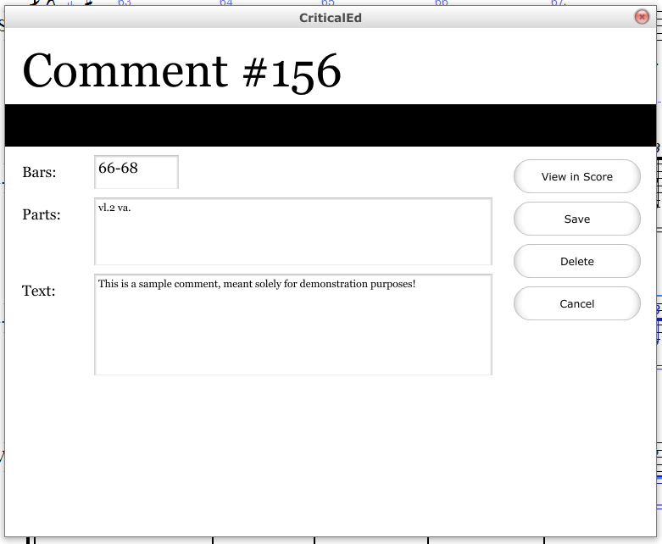
3: Going back and forth

Slide 11
4: Embedding Examples (TODO)
Currently TODO, but will initially be done by uploading image examples to the database.
SMUFL font will be used for in-line symbols.
In a future revision, it will be possible to embed examples in MEI format.

Slide 12
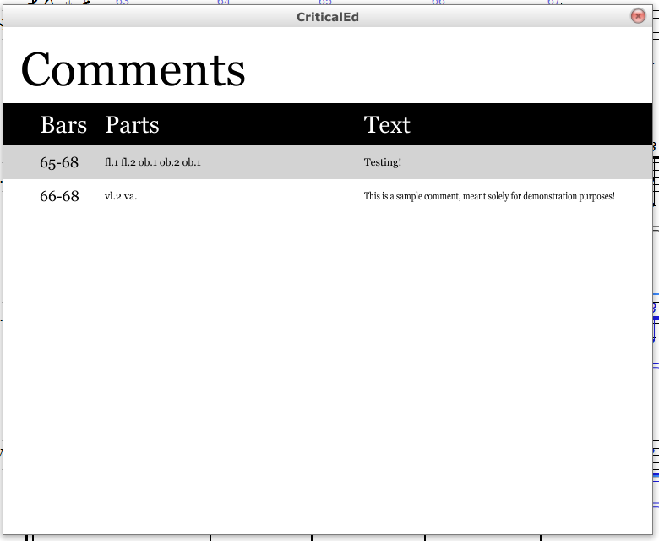
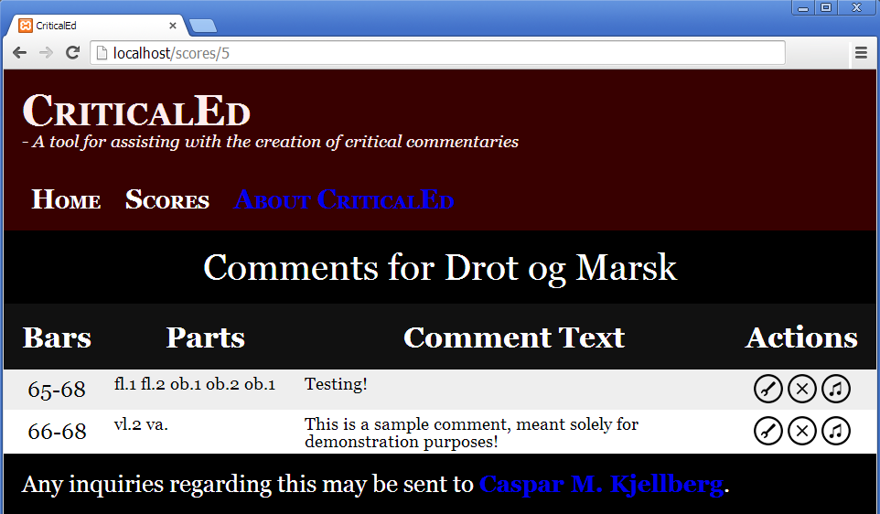
The Comment List

Slide 13
Supporting Other Notation Software
In order to support other notation software, the built-in scripting language must support three features.
Gathering position and instrument data from the current selection.
Adding lines and text to the score (or another way to add visual indication).
Basic file input/output operations (reading/appending lines).

Slide 14
Current status
Still experimental, but last round of testing will finish by June 14th.
To be released for public scrutiny on July 1st, after I finish my Master’s thesis.
Largely based on DCM’s needs, but was designed to be usable by other editing houses.
Suggestions for features and improvements more than welcome! (send me a mail: mail@caspark.com)

Slide 15
Questions?

