Slide 1
Modelling novice and expert listeners’ ability to detect changes in short melodies
Kat Agres^{1,2}, David Meredith³
1 Social & Cognitive Computing Dep’t, Institute of High Performance Computing, A*STAR, Singapore 2 Conservatory of Music, National University of Singapore (NUS), Singapore
3 Aalborg University, Denmark
^{ICMPC 2018, Sydney}
Email: kat_agres@ihpc.a-star.edu.sg
www.katagres.com

Slide 2
Background
Short-term musical memory and melodic change detection (ChDet) have received significant attention in the literature… (add some refs) but the relative influence of different psycho-musical parameters on ChDet performance is not well understood.
Which combination of parameters best predicts ChDet performance?
To address this question, we developed a novel computational model
Quantifies the perceptual salience of notes (tonal and rhythmic features)
Simulate the results of two previous change detection experiments (Agres, 2018)
?
?

Slide 3
Background
Systematically vary the weights (i.e., relative contribution to the model) of several rhythmic and tonal features --> discover which feature combinations best account for ChDet performance in musicians and non-musicians
Aim: Discovering the relative contribution of different features provides insight into the cognitive mechanisms underlying short-term memory for melodies

Slide 4
Background
Agres (2018; Psychology of Music) ChDet experiments
Listeners presented with pair of melodies on every trial
Task = indicate whether a standard and comparison melody were the same or different (different melodies contained one changed tone)
Listeners either professional musicians or non-musicians
Exp 1 stimuli:
72 melodic dyads (2 quarters, 4 eighths)
Stylistic, Non-stylistic, and Random
Exp 2 stimuli:
288 melodic dyads
Rhythm, Interval, Position, Tonality

Slide 5
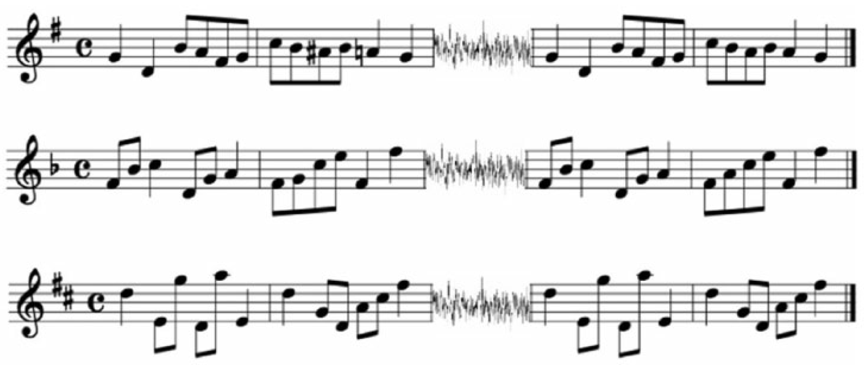
Examples of stimuli - Exp 1
Example stimuli used in Experiment 1. Each stimulus contains a two-measure melody, 500 ms of white noise, and a comparison two-measure melody. The melodies are, from top to bottom: stylistic (Different condition), non-stylistic (Different condition), and random (Same condition).

Slide 6
Examples of stimuli – Exp 2
Examples of Different stimuli from Experiment 2. Top: A scale–non-scale trial containing a minor third non-scale tone change on the first metrical position of rhythm 1. Bottom: A scale–scale trial containing a major third tone change on the first metrical position of rhythm 2.
Notes:
Top stimulus is r1p1i3t2a

Slide 7
Method: Overview
Computational model to predict the likelihood of a change being detected in each pair of melodies (calculated for all melodic dyads within a single experiment)
We compute which combination of weighted salience features best predicts professional musicians’ and non-musicians’ ChDet performance in both experiments
Salience of each note quantified as weighted sum of its duration, the metrical strength of its onset time, tonal stability and tonal instability
Rhythmic features (computed for entire melody)
Duration salience = a linear relationship with note length
Metrical salience = based on the metrical strength of a note’s onset time
Tonal features (computed for BOTH melody 1 and melody 2 of dyad)
Tonal stability = value of pitch class of the changed or to-be-changed tone according to the tonal hierarchy (see Krumhansl, 1990) divided by the value of the tonic of the key
Tonal instability = the inverse of tonal stability , or 1-Tonal stability
Notes:
Six features
Rhythmic features
Duration salience (dur)
Metrical salience (met)
Melody 1 tonal features
Tonal stability of first melody (ton1)
Tonal instability of first melody (ins1)
Melody 2 tonal features
Tonal stability of second melody (ton2)
Tonal instability of second melody (ins2)
Calculated for all pairs within a single experiment.
Correlation of computed results compared with experimental results calculated for non-musicians and for professional musicians for each experiment.

Slide 8
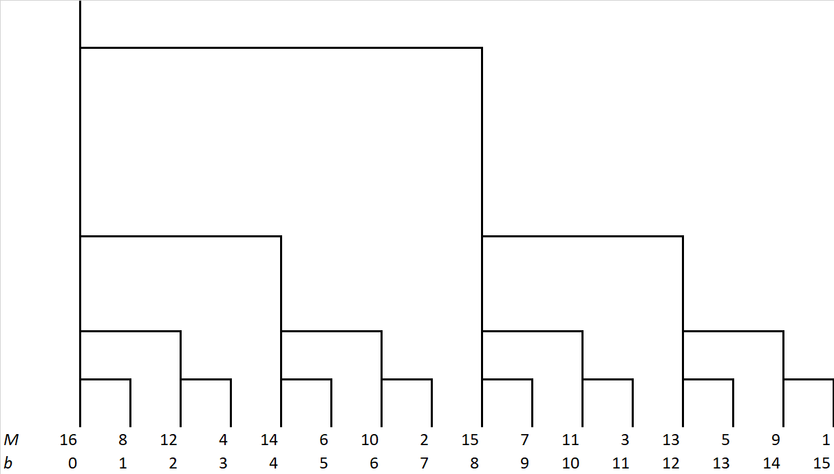
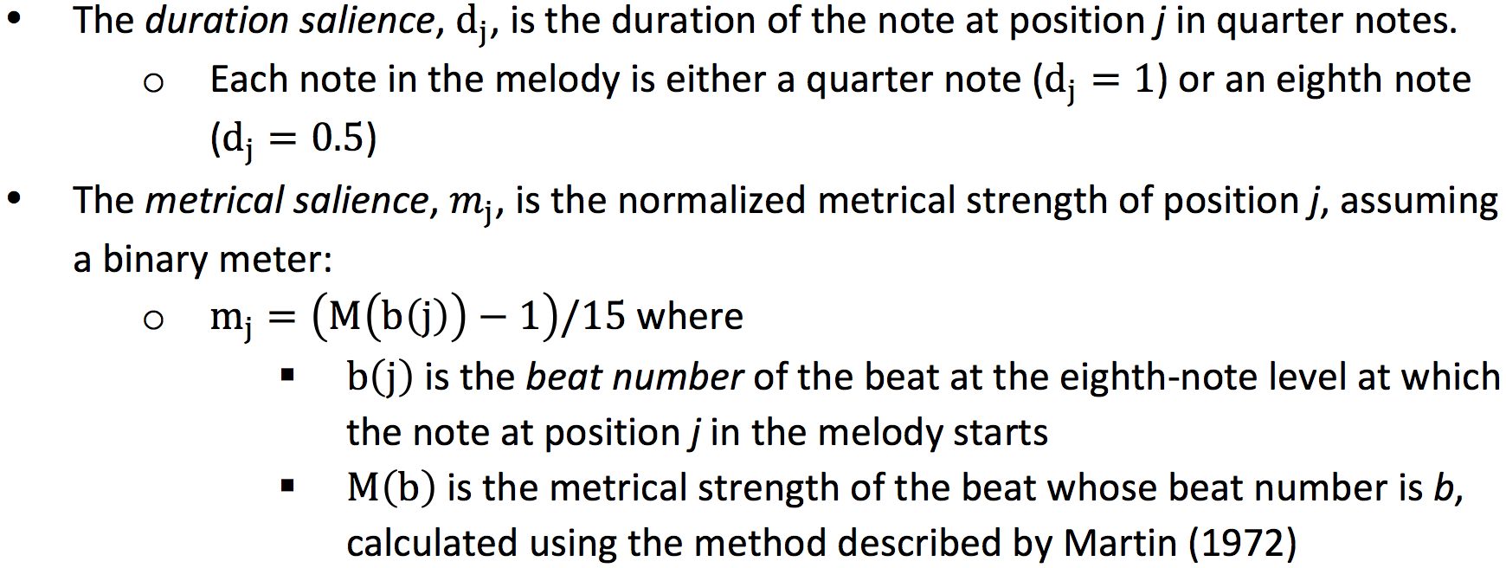
Calculating saliences: Rhythmic
Notes:
For Metrical salience, we have (M(b(j)) - 1) / 15 so that our salience values range from 0 to 1. If we used the second expression, there would never be a zero salience, so the measure would not be properly normalized to the range 0-1.

Slide 9
Calculating saliences: Tonal
Example: In the key of D, the note F would have tonal stability 2.33 / 6.35 = 0.367
and would have tonal instability of 1 – 0.367 = 0.633
Notes:
For Metrical salience, we have (M(b(j)) - 1) / 15 so that our salience values range from 0 to 1. If we used the second expression, there would never be a zero salience, so the measure would not be properly normalized to the range 0-1.

Slide 10
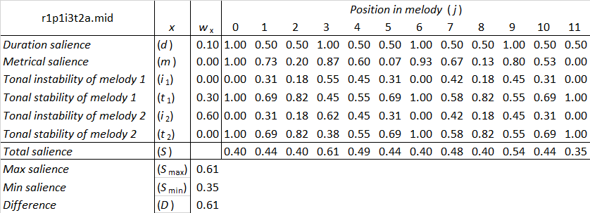
Predicting the perceived difference between melodies
0 1 2 3 4 5 6 7 8 9 10 11
0 1 2 3 4 5 6 7 8 9 10 11
Notes:
Example of computing the predicted difference between the two melodies in a single stimulus
Table shows the various salience values for all the positions in the given example
At bottom right is a description of how the difference is calculated for a given stimulus.
We explored the space of possible weight combinations where the sum of the weights is 1 and each weight was in the range 0 to 1 with 0.1 gradations
When the melodies are the same, the model predicts that the perceived difference will be greater when there is a greater range of saliences across the positions
When the melodies are different, the model predicts that the perceived difference will be greater when the salience of the changed note is higher
The rationale is that if the two melodies are actually identical, then there is no measurable difference between them. However, listeners might be more easily persuaded that the two melodies are different if there are no relatively highly salient events that help the listener to construct some sort of "deep structure" for the melody that lets them encode it more accurately. If there is only a very narrow range of saliences over the event positions in the melody, then we hypothesize that the listener is less able to construct an overall structure that helps them to remember the melody more precisely.
If the melodies are actually different, then we hypothesise that the listener is more likely to detect this difference if the difference occurs at a highly salient position. Perhaps one could argue that this difference should be given relative to the overall range of saliences of the position (e.g., (S_k - S_min)/(S_max - S_min)).

Slide 11
Calculating saliences
0 1 2 3 4 5 6 7 8 9 10 11
0 1 2 3 4 5 6 7 8 9 10 11

Slide 12
Results
Tonal instability in the comparison melody was the largest, most reliable predictor of ChDet performance for both musicians and non-musicians
Due to the salience of non-diatonic tones in otherwise diatonic contexts, e.g. temporal asymmetry effects (Krumhansl, 1990)
Note duration and Tonal stability in the first melody
For musicians only: Tonal instability in the first melody

Slide 13
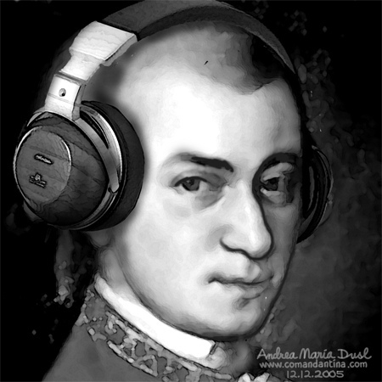
Results
Modelled non-musicians’ performance with a correlation of R² = 0.51 (Exp 1) and R² = 0.55 (Exp 2)
Modelled musicians’ performance with a correlation of R² = 0.58 (Exp 1) and R² = 0.65 (Exp 2)
All correlations were at a significance level of p < 0.001

Slide 14
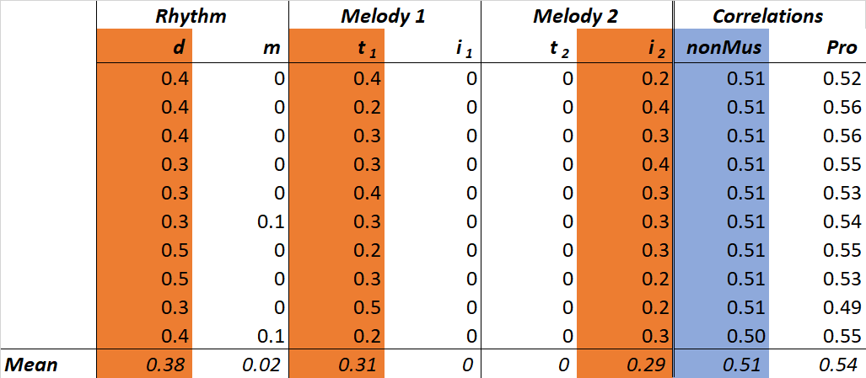
Exp 1: Top ten weighting combinations for non-musicians

Slide 15
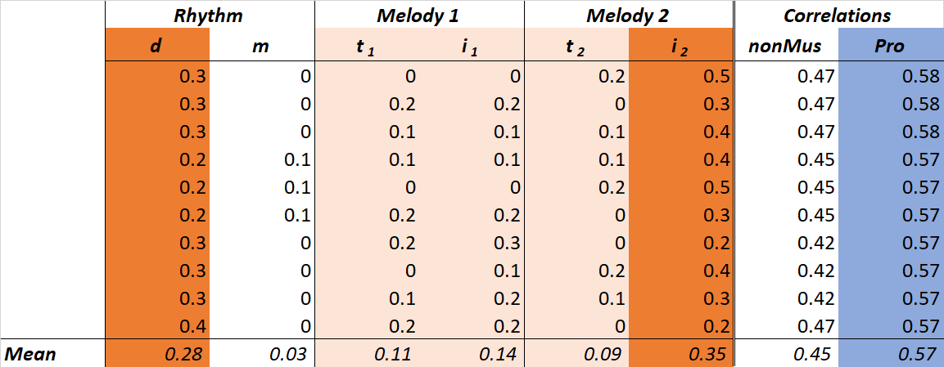
Exp 1: Top ten weighting combinations for musicians

Slide 16
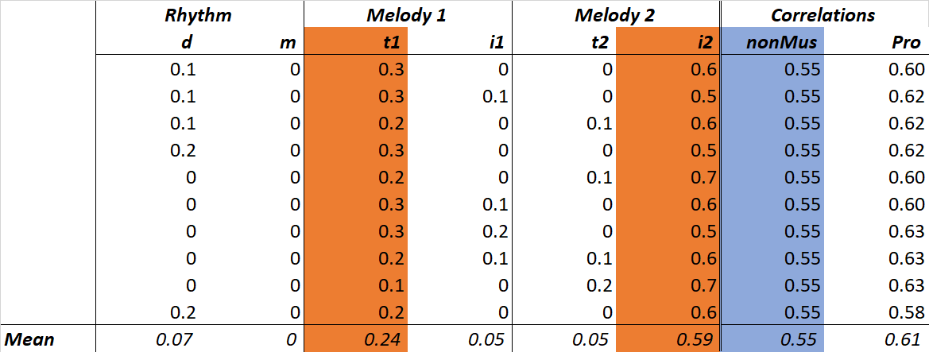
Exp 2: Top ten weighting combinations for non-musicians

Slide 17
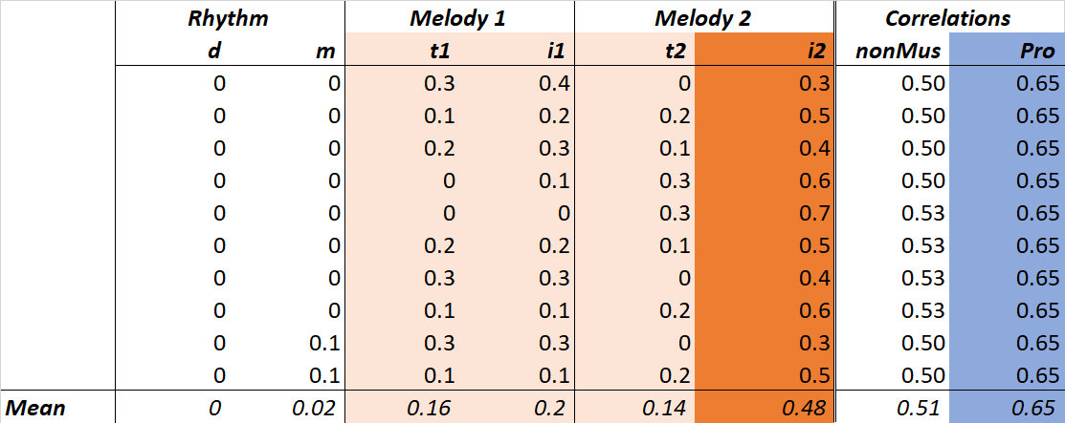
Exp 2: Top ten weighting combinations for musicians

Slide 18
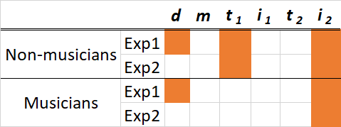
Conclusions: Overview of findings
Tonal instability (i₂) of the second melody the largest predictor of ChDet, followed by duration (d), and tonal stability (t). Tonal instability (i₁) of the first melody also had some effect for musicians.

Slide 19
Conclusions
Used a linear combination of rhythmic and tonal features to predict listeners’ ability to detect tone changes in pairs of brief melodies
Most important factor for musicians and non-musicians: tonal instability of the notes in the second melody
Other main contributing factors were note duration, tonal stability, and tonal instability of the first melody
These features are most likely to drive listeners' change detection performance in music

Slide 20
References
Agres, K. (2018). Change detection and schematic processing in music. Psychology of Music. DOI: 10.1177/0305735617751249.
Krumhansl, C. L. (1990). Cognitive Foundations of Musical Pitch. New York, NY. Oxford University Press.
Martin, J, G. (1972). Rhythmic (hierarchical) versus serial structure in speech and other behavior. Psychological Review, 79(6):487-509.

Slide 21
Thank you for listening!
Email: kat_agres@ihpc.a-star.edu.sg
www.katagres.com

Slide 22
Background
Although short-term musical memory and melodic change detection (ChDet) have received significant attention in the literature, the relative influence of different psycho-musical parameters on ChDet performance is not well understood. With the aim of determining which combination of parameters best predicts ChDet performance, we developed a computational model, based on the perceptual salience of notes arising from tonal and rhythmic features, to simulate the results of two previous change detection experiments (Agres, 2018). In these experiments, the listener’s task on each trial was to indicate whether a standard and comparison melody were the same or different (different melodies contained one changed tone). Listeners were either professional musicians or non-musicians.

Slide 23
Aims
Our goal is to simulate results from two ChDet experiments using a novel computational approach. By systematically varying the weights (i.e., relative contribution to the model) of several rhythmic and tonal features, we aim to discover which feature combinations best account for ChDet performance in musicians and non-musicians, thereby providing insight into the cognitive mechanisms underlying short-term memory for melodies.

Slide 24
Method
We developed a rule-based model to predict the likelihood of a change being detected in each pair of melodies. The model quantifies the salience of each note as a weighted sum of its duration, the metrical strength of its onset time, tonal stability and tonal instability. Tonal stability is calculated by dividing the value of the pitch class of the changed or to-be-changed tone (according to the tonal hierarchy; see Krumhansl, 1990) by the value of the tonic of the key, tonal instability is calculated as 1-tonal stability, duration salience has a linear relationship with note length, and metrical salience is based on the metrical strength of a note’s onset time. A maximum of one non-diatonic tone could occur in either the standard or deviant melody. We compute which combination of weighted salience features best predicts listeners’ ChDet performance. We explore the effect of musical experience by comparing the optimal relative weightings of the various features for musicians with those for non-musicians. Seventy-two melodies were used, including 36 stylistic melodies conforming to traditional Western musical norms, 18 non-stylistic melodies containing unusual melodic leaps or implied harmonies and 18 random melodies in which the tones were randomly selected from a diatonic scale. Stylistic and non-stylistic melodies could contain non-diatonic tones.

Slide 25
Results
We discovered that tonal instability in the comparison melody was the largest, most reliable predictor of ChDet performance for both musicians and non-musicians, perhaps due to the salience of non-diatonic tones in otherwise diatonic contexts (see also temporal asymmetry effects in Krumhansl, 1990). Note duration and tonal stability in the first melody also had an effect, as did tonal instability in the first melody (for musicians only). We were able to model non-musicians’ performance with a correlation of 0.51 (Exp 1) and 0.55 (Exp 2), and musicians’ performance with a correlation of 0.58 (Exp 1) and 0.65 (Exp 2). All correlations were at a significance level of p < 0.001.

Slide 26
Conclusions
By using a linear combination of rhythmic and tonal features, we were able to model listeners’ ability to detect tone changes in pairs of brief melodies. Our results indicate that an important factor for both musicians and non-musicians is the tonal instability of the notes in the second melody presented. The other main contributing factors were note duration, tonal stability and tonal instability in the first melody. This approach allowed us to discover which features are most likely to drive listeners' change detection performance in music.

