Slide 1
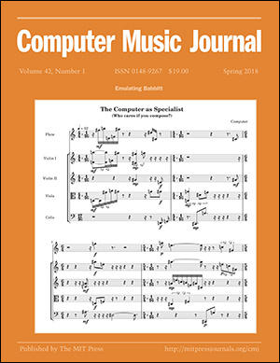
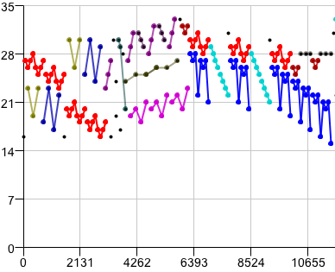


Computational Music Analysis and Generation
David Meredith
dave@create.aau.dk

Slide 2
David Meredith (2009 – Present)
Brian Bemman (2013 – Present)
Olivier Lartillot (2014 – 2017)
Gissel Velarde (2012 – 2017)

Slide 3
Research topics
Compression-based methods for music analysis
  Meredith, Louboutin
Pattern discovery in music
  Meredith, Lartillot, Velarde, Weyde, Collins
Modelling Milton Babbitt’s compositional processes
  Bemman, Meredith, Tanaka
Convolutional methods for music analysis
  Velarde, Meredith, Weyde, Cancino-Chacòn, Grachten
Modelling change-detection in music
  Agres, Meredith
Modelling groove and the perception of syncopation
  Bemman, Christensen
Perception of segmentation in music
  Hartmann, Lartillot, Toiviainen
ERP studies on listening to entire pieces of music
  Lartillot, et al.

Slide 4
Co-authors
(since 2012)
Kat Agres, A*STAR, Institute of High Performance Computing, Singapore
Justin Christensen, Music Department, Aalborg University, Denmark
Tom Collins, Department of Psychology, Lehigh University, PA, USA
Anja Volk, Department of Computer Science, Utrecht University, Netherlands
Martin Hartmann, Department of Music, University of Jyväskylä, Finland
Petri Toiviainen, Department of Music, University of Jyväskylä, Finland
Axel Teich Geertinger, Det Kongelige Bibliotek, Copenhagen, Denmark
Corentin Louboutin, Université de Rennes I, Rennes, France
Hanna Poikonen, Cognitive Brain Research Unit, Univeristy of Helsinki, Finland
Vinoo Alluri, Department of Music, University of Jyväskylä, Finland
Elvira Brattico, Center for Music in the Brain, Aarhus University, Denmark
Pasi Saari, Department of Music, University of Jyväskylä, Finland
György Fazekas, Centre for Digital Music, Queen Mary University of London, UK
Tuomas Eerola, Department of Music, Durham University, UK
Mathieu Barthet, Centre for Digital Music, Queen Mary University of London, UK
Mark Sandler, Centre for Digital Music, Queen Mary University of London, UK
Tsubasa Tanaka, IRCAM, Paris, France
Tillman Weyde, City University of London, UK
Carlos Cancino Chacòn, Austrian Research Institute for Artificial Intelligence, Vienna, Austria
Maarten Grachten, Department of Computational Perception, Johannes Kepler University, Linz, Austria

Slide 5
Some numbers
(since 2012)
54 publications
  11 journal papers (8 at niveau 2; 2 at niveau 1)
  4 book chapters (1 at niveau 2; 3 at niveau 1)
  24 conference papers (7 at niveau 1)
  11 conference abstracts
  1 edited anthology
  1 conference proceedings
  2 PhD theses
40 BFI points
DKK 5,4 million in funding
  DKK 3,7 million (EUR 500k) from European Commission
    “Learning to Create”, FP7 FET project, 2013-2016
  DKK 1,7 million from department
    Department PhD stipend for Gissel Velarde

Slide 6
Modelling Milton Babbitt’s Compositional Processes
(Bemman, Meredith, Tanaka)

Slide 7

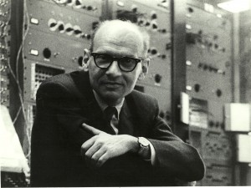
Computational modelling of Milton Babbitt’s compositional processes
Milton Babbitt (1916-2011)
  American composer, music theorist and mathematician
  wrote many articles on 12-tone music theory
  most of his later works based on the all-partition array and the principle of “maximal diversity”
Three Compositions for Piano (1947)
Sheer Pluck (Composition for Guitar) (1984)
By Source (WP:NFCC#4), Fair use,
https://en.wikipedia.org/w/index.php?curid=46987269

Slide 8
All-partition array
Array of pitch classes containing k lynes (k=4, 6 or 12)
  A lyne is a structural voice, distinguished from the other lynes by dynamics or register
Satisfies many tough constraints such as
  using all forms of a row exactly once
  using all partitions of 12 with k or fewer summands
    e.g., 58 different partitions when 6 lynes
  pairs of adjacent lynes contain rows arranged into hexachordally combinatorial pairs
  ...
Only a handful of all-partition arrays have ever been discovered

Slide 9
Automatic discovery of new partitionings of existing pitch class matrices
Problem of discovering an all-partition array given a matrix of pitch classes
Cast as a special case of the set-cover problem
Solved for a 4-lyne array using a constraint programming approach
  First time a novel partitioning has been found automatically
Subsequently solved for a 6-lyne array using a backtracking algorithm starting at both the beginning and the end of the matrix, guided by heuristics based on the number of compositions for each given partition
First time a solution to this problem has been found entirely by computer
Tanaka, T., Bemman, B.M. and Meredith, D. (2016). Constraint programming approach to the problem of generating Milton Babbitt's all-partition arrays. In Rueher, M. (ed.) Principles and Practice of Constraint Programming: 22nd International Conference, CP 2016, Toulouse, France, September 5-9, 2016 Proceedings, Lecture Notes in Computer Science, Vol. 9892, pp. 802-810. Springer, Cham, Switzerland.
  Bemman, B. and Meredith, D. (2016). Generating Milton Babbitt's all-partition arrays. Journal of New Music Research, 45(2). pp. 184-204.

Slide 10
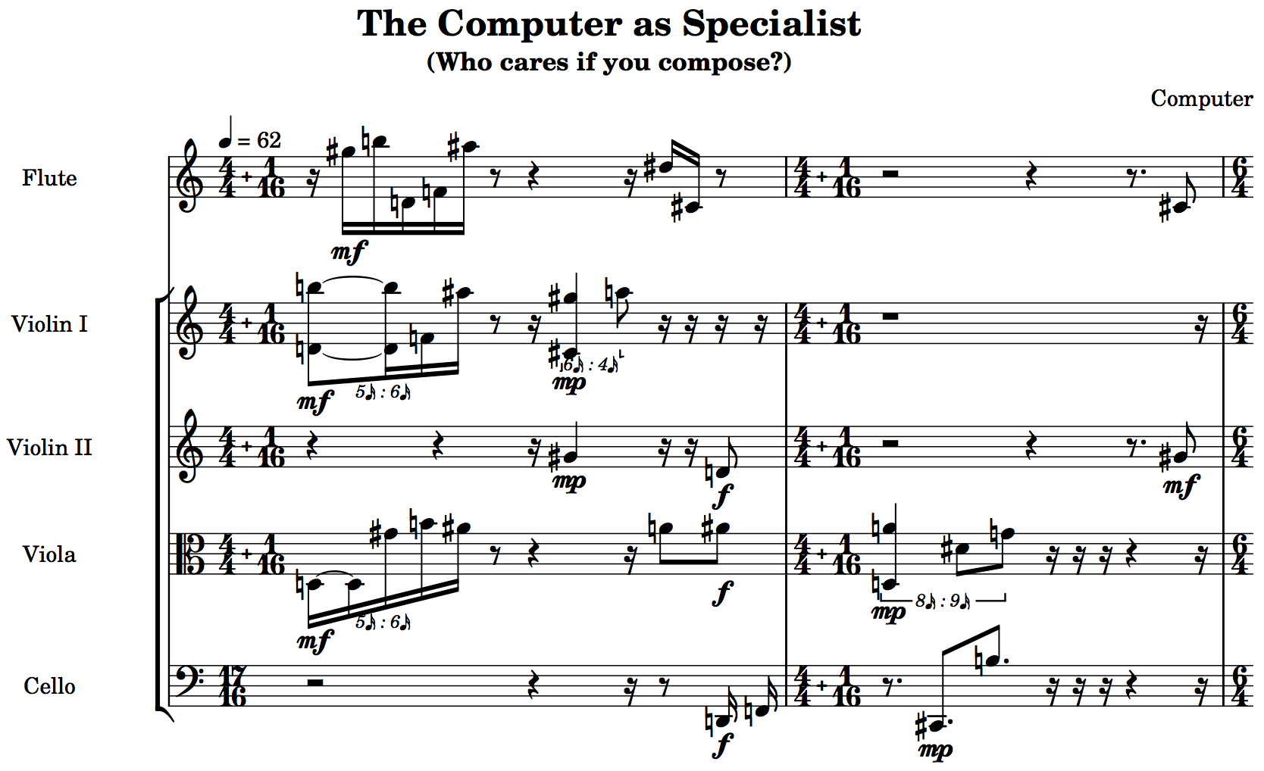

Generating novel works in the style of Babbitt
Automatically generated completely new piece based on the new 4-part array
  pitches, voicing, onsets, duration, metre and dynamics all generated automatically using discovered formalizations of the methods that Babbitt used
Bemman, B.M. and Meredith, D. (2018) Generating new musical works in the style of Milton Babbitt. Computer Music Journal, 42(1):60-79.
Bemman, B.M. and Meredith, D. (2018) Predicting Babbitt’s time-point rows in None but the Lonely Flute and Around the Horn. Journal of Mathematics and Music, 12(1):1-19.

Slide 11
Computational modelling of Babbitt’s compositional processes
Bemman, B. and Meredith, D. (2016). Generating Milton Babbitt's all-partition arrays. Journal of New Music Research, 45(2). pp. 184-204.
Tanaka, T., Bemman, B.M. and Meredith, D. (2016). Constraint programming approach to the problem of generating Milton Babbitt's all-partition arrays. In Rueher, M. (ed.) Principles and Practice of Constraint Programming: 22nd International Conference, CP 2016, Toulouse, France, September 5-9, 2016 Proceedings, Lecture Notes in Computer Science, Vol. 9892, pp. 802-810. Springer, Cham, Switzerland.
Tanaka, T., Bemman, B. M. and Meredith, D. (2016). Integer programming formulation of the problem of generating Milton Babbitt's all-partition arrays. In 17th International Society for Music Information Retrieval Conference (ISMIR 2016), 7-11 August 2016, New York, NY.
Bemman, B. M. and Meredith, D. (2015). Exact cover problem in Milton Babbitt's all-partition array. In T. Collins, D. Meredith and A. Volk (eds.) Mathematics and Computation in Music: 5th International Conference, MCM 2015, London, UK, June 22-25, 2015 Proceedings, Lecture Notes in Artificial Intelligence, Vol. 9110, pp. 237-242. Springer, Berlin.
Bemman, B. M. and Meredith, D. (2015). Comparison of heuristics for generating all-partition arrays in the style of Milton Babbitt. In 11th International Symposium on Computer Music Multidisciplinary Research, 16-19 June 2015, Plymouth, UK.
Bemman, B. M. and Meredith, D. (2014). From analysis to surface: Generating the surface of Milton Babbitt's Sheer Pluck from a parsimonious encoding of an analysis of its pitch-class structure. The Music Encoding Conference, 20-23 May 2014, University of Virginia, Charlottesville, VA., USA. pp. 147-152.
Bemman, B. M. and Meredith, D. (2014). Anatomy of the six-part all-partition array as used by Milton Babbitt: Preliminary efforts towards a computational method of automatic generation. RMA Music and Mathematics Study Day, 12 April, 2014, University of Leeds, UK.
Bemman, B.M. and Meredith, D. (2018). Generating new musical works in the style of Milton Babbitt. Computer Music Journal, 42(1):60-79.
Bemman, B.M. and Meredith, D. (2018). Predicting Babbitt's orderings of time-point classes from array aggregrate partitions in None but the Lonely Flute and Around the Horn. Journal of Mathematics and Music, 12(1):1-19.
Bemman, B.M. (2017). Computational problems in modeling Milton Babbitt’s compositional process. Aalborg University, Denmark.

Slide 12
Convolutional Methods for Music Analysis
(Velarde, Meredith, Weyde, Cancino-Chacòn, Grachten)
Notes:
Variable-Q transform better simulates frequency resolution of the human auditory system by having constant Q at about 500Hz and above, and then lower Q below 500Hz. The degree of non-linearity is determined by the parameter gamma, which we set to 20. This corresponds to the fact that music signals generally do not contain closely-spaced pitches at low frequencies. Reducing Q in the lower frequencies also speeds computation. See Schörkhuber et al 2014, AES 53rd International Conference, London.

Slide 13
Convolution-based methods for music analysis:
Filtered 2-d pitch-time representations
Methods take 2-d grey-scale images of pitch-time representations of pieces of music as input
Can therefore be applied to audio or symbolic representations
  Velarde, G., Weyde, T., Cancino Chacon, C., Meredith, D. and Grachten, M. (2016). Composer recognition based on 2d-filtered piano-rolls. In 17th International Society for Music Information Retrieval Conference (ISMIR 2016), New York, NY.
  Velarde, G., Cancino Chacón, C., Meredith, D., Weyde, T. and Grachten, M. (2018). Convolution-based classification of audio and symbolic representations of music. Journal of New Music Research, 47(3):191-205.

Slide 14
Convolution-based music classification
Input is symbolic or audio music encoding
Piano-roll or spectrogram sampled to a greyscale image
Either segmented or whole excerpt used as an item
Segments/excerpts optionally filtered using a gaussian filter
Classified using SVM or k-NN
  Velarde, G., Weyde, T., Cancino Chacon, C., Meredith, D. and Grachten, M. (2016). Composer recognition based on 2d-filtered piano-rolls. In 17th International Society for Music Information Retrieval Conference (ISMIR 2016), New York, NY.
  Velarde, G., Cancino Chacón, C., Meredith, D., Weyde, T. and Grachten, M. (2018). Convolution-based classification of audio and symbolic representations of music. Journal of New Music Research, 47(3):191-205.
Notes:
SVMs trained with one vs. one coding design based on error-correcting codes, linear kernels with sequential minimal optimisation and Karush-Kuhn-Tucker conditions set to 0.001, samples normalized around the mean, scaled to have unit standard deviation
K-nn uses Euclidean distance and next nearest point to break ties; Davies and Bouldin (1979) criterion used to select k with smallest dispersion of clusters and centroids’ distances, 3 <= k <= 21, k odd

Slide 15
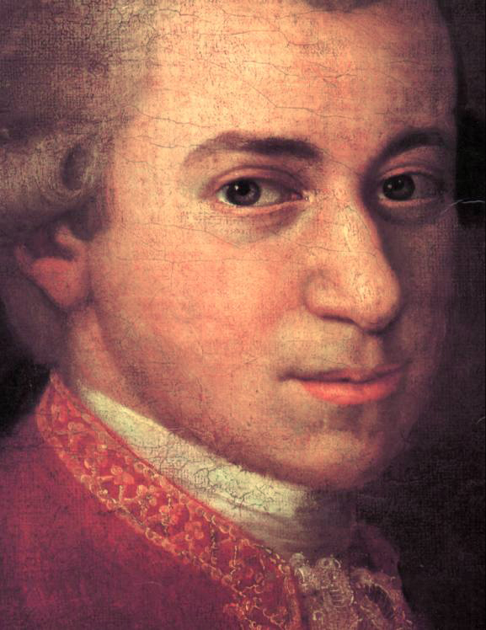
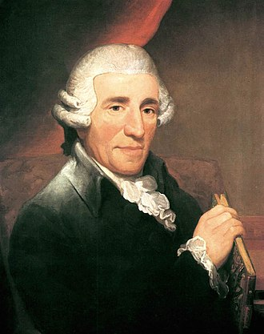
Discrimination between Haydn and Mozart
String Quartet No. 1 in G, K.80: I. Adagio
String Quartet in B flat major, Hob. III:1, Op. 1 No.1 “La chasse”: III. Adagio
Reached state-of-the-art performance on Mozart-Haydn task
Performed equally well on audio and symbolic data
Uses no music-specific knowledge (unlike previous state-of-the-art approaches)

Slide 16
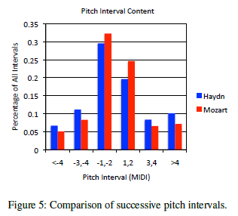
Experiments with convolutional neural networks (CNNs)
“Mozart has significantly more seconds … than Haydn”
(Herlands et al., 2014, p.281)
Datasets | CNN-p400n | C1S-p400n
HM107 | 0.776 | 0.729
HM207 | 0.560 | 0.667

Slide 17
Convolutional methods for music analysis
Velarde, G., Cancino Chacòn, C., Meredith, D., Weyde, T. and Grachten, M. (2018). Convolution-based classification of audio and symbolic representations of music. Journal of New Music Research, 47(3):191-205.
Velarde, G., Weyde, T. and Meredith, D. (2013). An approach to melodic segmentation and classification based on filtering with the Haar-wavelet. Journal of New Music Research, 42(4), pp. 325-345.
Velarde, G., Meredith, D. and Weyde, T. (2016). A wavelet-based approach to pattern discovery in melodies. In Meredith, D. (ed.) Computational Music Analysis, pp. 303-333. Springer.
Velarde, G. and Meredith, D. (2016). Wavelet-based approach to the discovery of themes and sections in monophonic melodies. MIREX 2016, New York, USA. Competition on Discovery of Repeated Themes and Sections.
Velarde, G., Weyde, T., Cancino Chacon, C., Meredith, D. and Grachten, M. (2016). Composer recognition based on 2d-filtered piano-rolls. In 17th International Society for Music Information Retrieval Conference (ISMIR 2016), 7-11 August 2016, New York, NY.
Velarde, G. and Meredith, D. (2014). A wavelet-based approach to the discovery of themes and sections in monophonic melodies. Music Information Retrieval Evaluation Exchange (MIREX 2014), Competition on Discovery of Repeated Themes and Sections, 27-31 October 2014, Taipei, Taiwan.
Velarde, G. and Meredith, D. (2014). Melodic pattern discovery by structural analysis via wavelets and clustering techniques. Eighth European Music Analysis Conference (EuroMAC2014), 17-20 September 2014, Leuven, Belgium.
Velarde, G., Weyde, T. and Meredith, D. (2013). Wavelet-filtering of symbolic music representations for folk tune segmentation and classification. Third International Workshop on Folk Music Analysis (FMA 2013), (6-7 June 2013), Meertens Institute, Amsterdam, The Netherlands.
Velarde, G. (2017). Convolutional methods for music analysis. PhD thesis, Aalborg University.

Slide 18
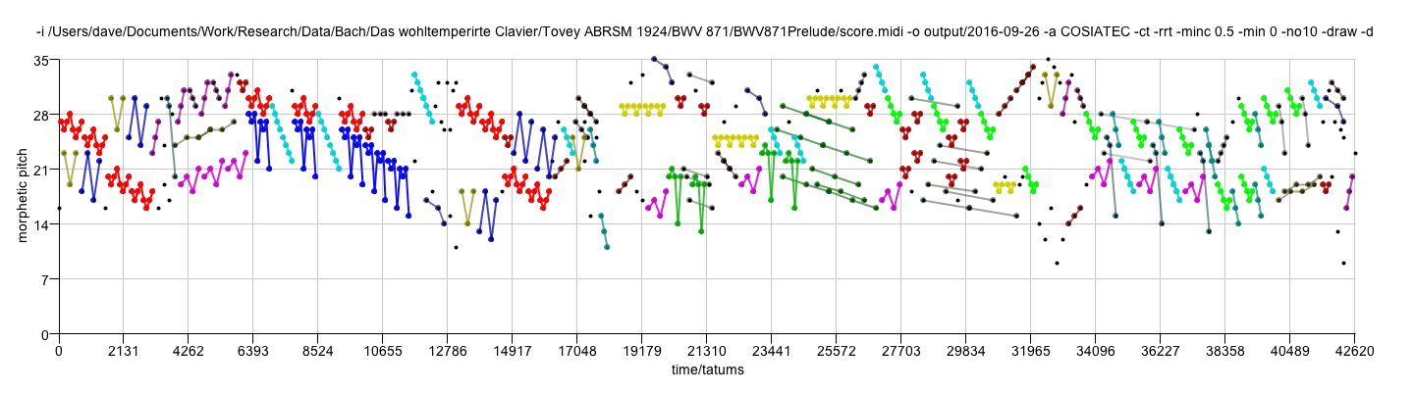
Geometric, compression-based pattern discovery in music
J. S. Bach, Prelude No. 2 in C minor, BWV 871
from Book 2 of The Well-Tempered Clavier
Performed by Angela Hewitt

Slide 19
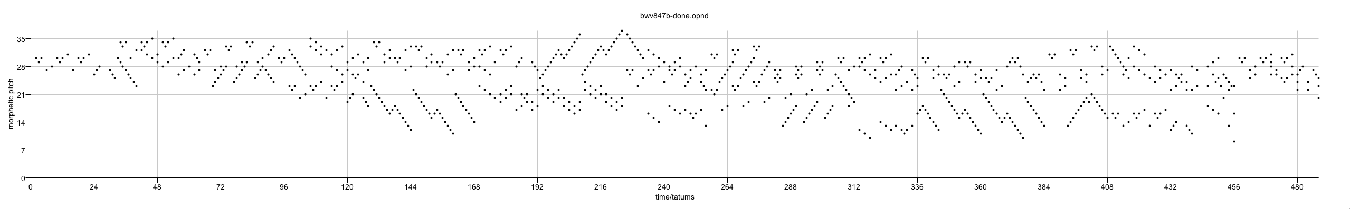
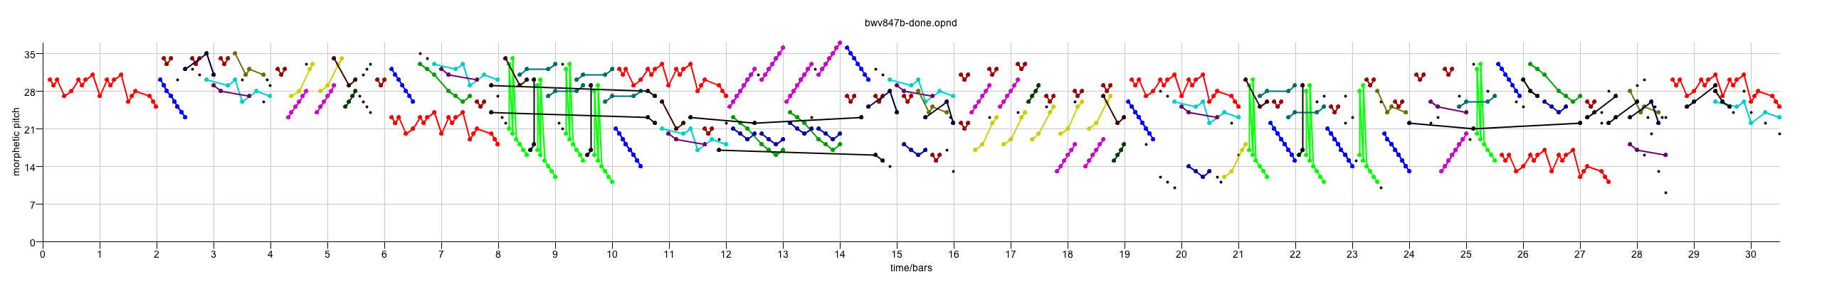
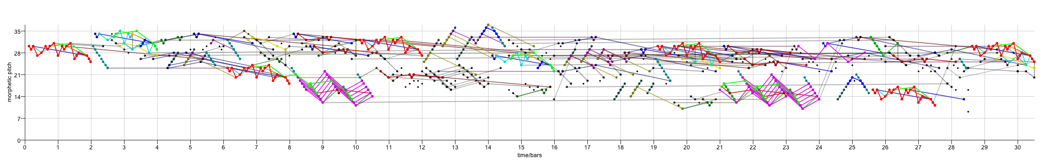
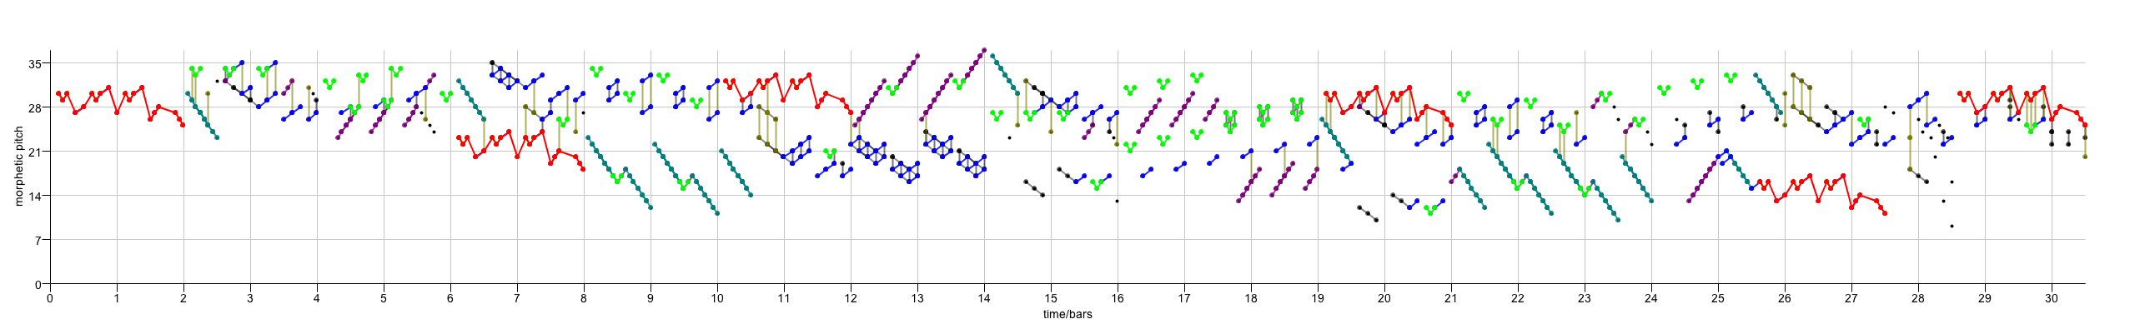
Music analysis and point-set compression
Input point set
J. S. Bach, Fugue in C minor, BWV 847
COSIATEC
SIATECCompress
Forth’s algorithm

Slide 20
Using point-set compression algorithms for folk-song classification
Meredith, D. (2015). Music analysis and point-set compression. Journal of New Music Research, 44(3), pp. 245-270.

Slide 21
Point-set compression algorithms on JKU-PDD
Meredith, D. (2015). Music analysis and point-set compression. Journal of New Music Research, 44(3), pp. 245-270.

Slide 22
Some interesting non-ground-truth patterns discovered by COSIATEC
The “most characteristic segment [of the second countersubject] contains the first four eighth-notes’
(Bruhn, 1993, http://www-personal.umich.edu/~siglind/wtc-ii-20.html)
Meredith, D. (2015). Music analysis and point-set compression. Journal of New Music Research, 44(3), pp. 245-270.

Slide 23
Results of point-set compression algorithms does not fully support parsimony principle – why?
Louboutin, C. and Meredith, D. (2016). Using general-purpose compression algorithms for music analysis. Journal of New Music Research, 45(1), pp. 1-16.

Slide 24
Using general-purpose compression algorithms for music analysis
Compared LZ77, LZ78, Burrows-Wheeler and COSIATEC on classifying folk songs in the NLB
  k-nearest neighbour
  combined representations (ensemble) classification method
  novel similarity metric, corpus compression distance, based on NCD
Compared LZ77 and COSIATEC on discovery of fugue subject and countersubject entries in WTC1
Louboutin, C. and Meredith, D. (2016). Using general-purpose compression algorithms for music analysis. Journal of New Music Research, 45(1), pp. 1-16.

Slide 25
Single-viewpoint NLB classification
Louboutin, C. and Meredith, D. (2016). Using general-purpose compression algorithms for music analysis. Journal of New Music Research, 45(1), pp. 1-16.

Slide 26
Combined viewpoints NLB classification
(Ensemble classifiers)
10’ is obtained by combining 8 of the 10 best compressed viewpoints, omitting (LZ77, int0 * ioi) and (COSIATEC,int)
Louboutin, C. and Meredith, D. (2016). Using general-purpose compression algorithms for music analysis. Journal of New Music Research, 45(1), pp. 1-16.

Slide 27
Compression-based methods for music analysis
Louboutin, C. and Meredith, D. (2016). Using general-purpose compression algorithms for music analysis. Journal of New Music Research, 45(1), pp. 1-16.
Meredith, D. (2016). Analysing music with point-set compression algorithms. In Meredith, D. (ed.) Computational Music Analysis, pp. 335-366. Springer.
Meredith, D. (2015). Music analysis and point-set compression. Journal of New Music Research, 44(3), pp. 245-270.
Meredith, D. (2016). Geometric, compression-based pattern discovery in music. ZiF Workshop on "From Computational Creativity to Creativity Science", Zentrum für interdisciplinäre Forschung, Bielefeld, Germany.
Meredith, D. (2016). Using SIATECCompress to discover repeated themes and sections in polyphonic music. MIREX 2016, Competition on Discovery of Repeated Themes and Sections, New York, USA.
Meredith, D. (2014). Music analysis and point-set compression. Eighth European Music Analysis Conference (EuroMAC2014), Leuven, Belgium.
Meredith, D. (2014). Using point-set compression to classify folk songs. Fourth International Workshop on Folk Music Analysis (FMA 2014), Istanbul, Turkey.
Meredith, D. (2014). Compression-based geometric pattern discovery in music. Fourth International Workshop on Cognitive Information Processing (CIP 2014), Copenhagen, Denmark.
Meredith, D. (2018). Music analysis and data compression. In Grimshaw, M., Walther-Hansen, M. and Knakkergaard, M. (eds.) The Oxford Handbook of Sound and Imagination. OUP.
Collins, T. and Meredith, D. (2013). Maximal translational equivalence classes of musical patterns in point-set representations. In J. Yust, J. Wild and J. A. Burgoyne (eds.) Mathematics and Computation in Music: 4th International Conference, MCM 2013, Montreal, QC, Canada, June 12-14, 2013. Proceedings, Lecture Notes in Computer Science, Vol. 7937, pp. 88-99. Springer, Berlin.
Meredith, D. (2013). COSIATEC and SIATECCompress: Pattern discovery by geometric compression. MIREX 2013, Curitiba, Brazil. Competition on Discovery of Repeated Themes and Sections.
Meredith, D. (2013). Analysis by compression: Automatic generation of compact geometric encodings of musical objects. The Music Encoding Conference 2013 (22-24 May 2013), Mainz Academy for Literature and Sciences, Mainz, Germany. pp. 41-53.
Meredith, D. (2012). A compression-based model of musical learning. DMRN+7: Digital Music Research Network One-day Workshop 2012 (18 December 2012), Queen Mary University of London.
Meredith, D. (2012). Music analysis and Kolmogorov complexity. In Proceedings of the 19th Colloquio di Informatica Musicale (XIX CIM) (21-24 November 2012), Trieste, Italy.
Meredith, D. (2012). A geometric language for representing structure in polyphonic music. In Proceedings of the 13th International Society for Music Information Retrieval Conference (ISMIR 2012) (8-12 October 2012), Porto, Portugal, pp. 133-138.

Slide 28
Book
Computational Music Analysis (Springer, 2016)
Edited anthology of 17 papers on computational music analysis, including 6 chapters on work arising from Lrn2Cre8

